Slide 1

OPW’s EDGE™
Double-Wall Spill Container
Easy, Affordable & EPA Compliant

Slide 2

Easy, Affordable & EPA Compliant
Get prepared and protected for overfill prevention equipment inspections with OPW’s 71SO-T Overfill Prevention Valve.
It’s the easiest, quickest and most cost-effective way to ensure that your overfill valves are operational, without having to remove them from the tanks.

Slide 3
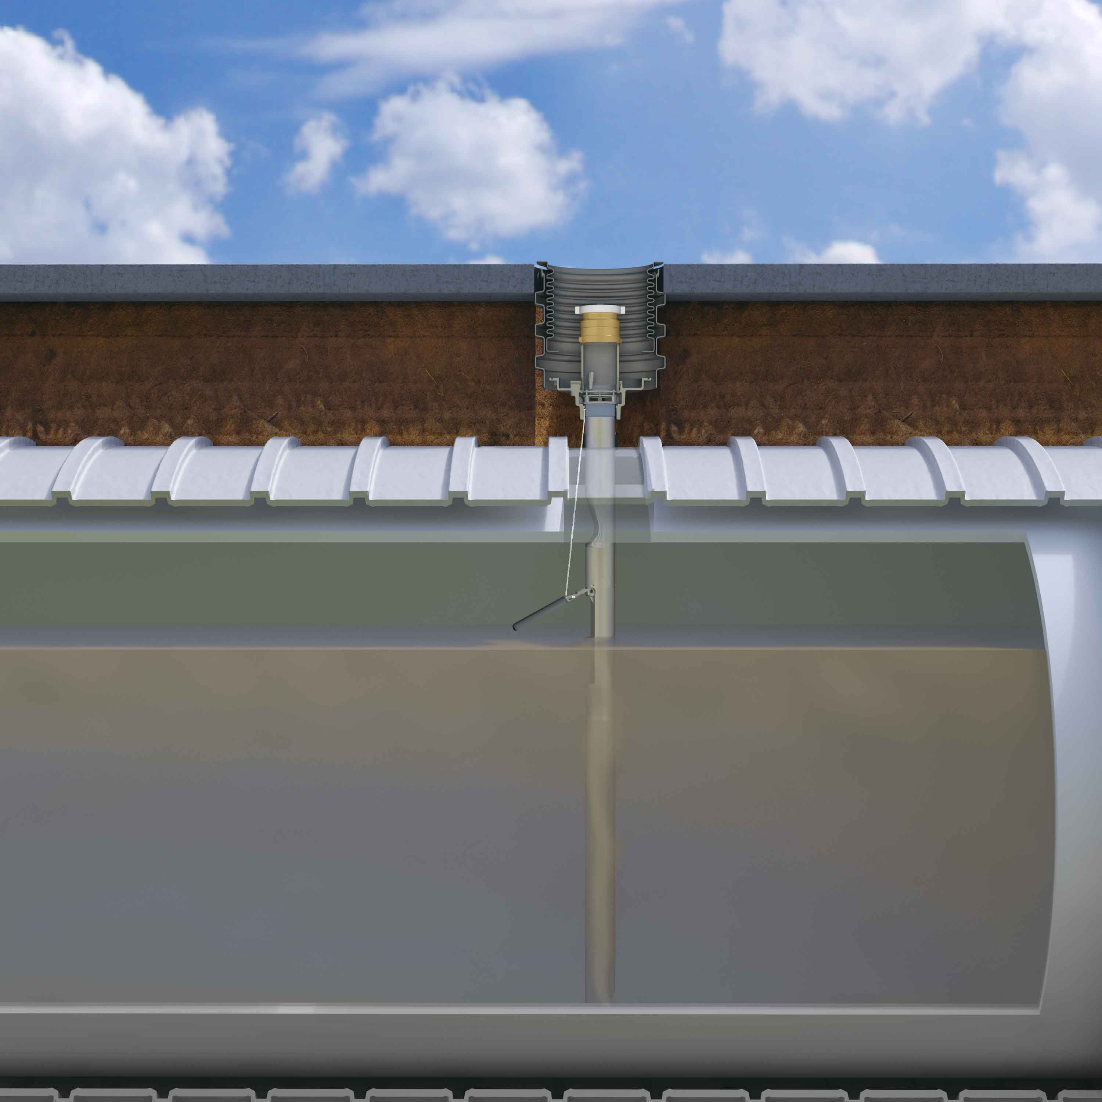
Testing & Verification – Easy as 1 • 2 • 3
The Only UST Overfill Prevention Valve that is testable without
removal from the tank
A testable feature is attached to a sealed plug in the inlet adapter
The plug is easily accessed with a standard socket extension
Attached to the extension, the testable feature can be raised and lowered, allowing the user to inspect the valve operation from the inside of the tube
The plug is then easily reinstalled to the inlet adapter from grade
No fill components, overfill valves, or vapor tight seals have to be removed - avoids compromising vapor tight compliance
The Testable 71SO-T uses the same industry leading overfill prevention technology for strong vapor tight compliance

Slide 4
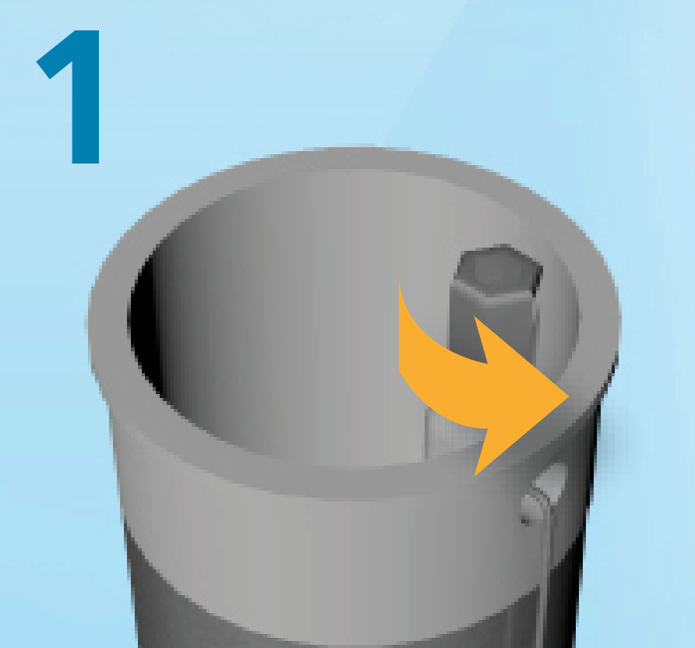
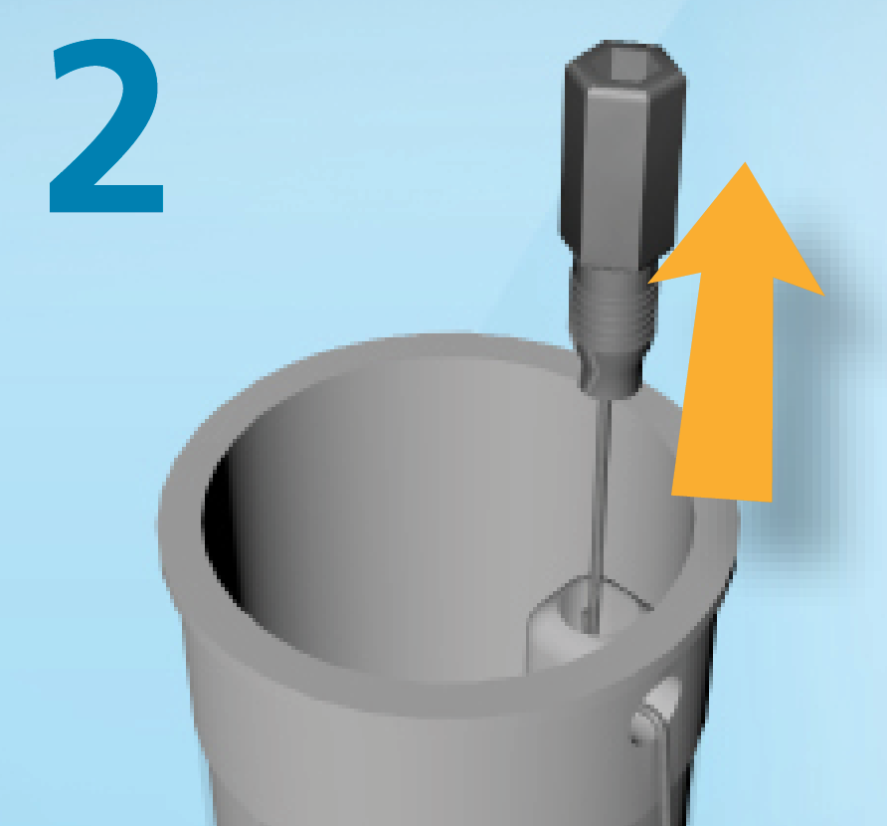
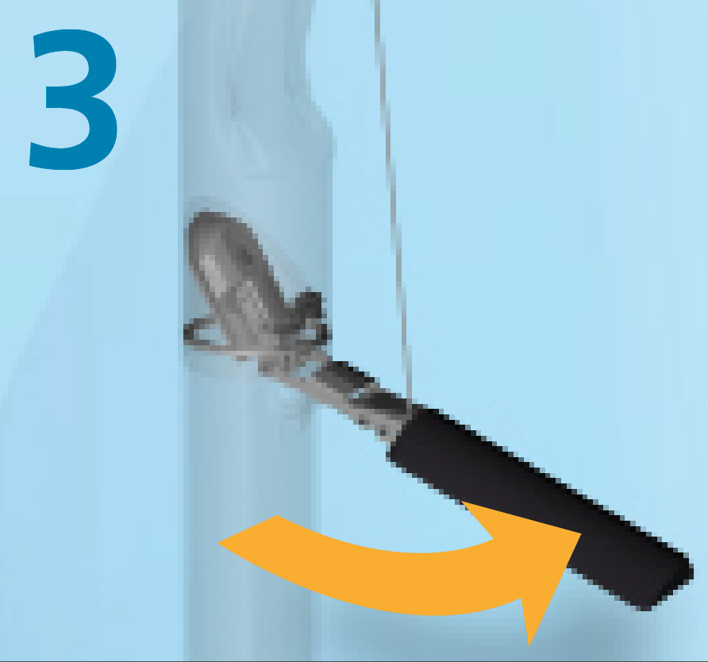
Testing & Verification – Easy as 1 • 2 • 3
Loosen test plug
Lift float with cable to simulate fill
Validate proper
poppet operation

Slide 5
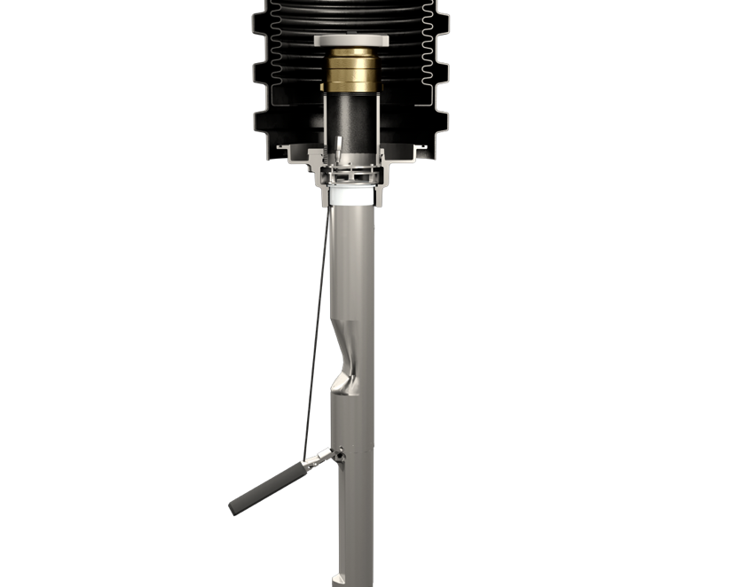
Unique Feature Set
Test Plug
Cable
Float

Slide 6
Ordering Specifications – Replacement Parts
Part Number | Description | A- Upper Tube Length |  |  | B- Lower Tube Length |  | C- Overall Length |  | Max. Riser Length |  | Max. Nominal Tank Diameter |  | Max. Actual Tank Diameter |  | Weight
 |  | In. |  | m | In. | m | In. | m | In. | m | In. | In. | In. | m | In. | m
71SO-400CT | Testable Vapor-Tight Overfill Valve, 5 Ft. Bury, 8 Foot Tank | 60 | 1.5 |  | 83 | 2.1 | 154-3/4 | 3.9 | 53-1/2 | 1.4 | 96 | 2.4 | 107 | 2.7 | 16 | 7
71SO-400CT | Testable Vapor-Tight Overfill Valve, 10 Ft. Bury, 10 Foot Tank | 120 | 3.1 |  | 102 | 2.6 | 234-3/4 | 5.9 | 113-1/2 | 2.9 | 120 | 3.1 | 126 | 3.2 | 25 | 11
71SO-400CT | Testable Vapor-Tight Overfill Valve, 10 Ft. Bury, 12 Foot Tank | 120 | 3.1 |  | 126 | 3.2 | 258-3/4 | 6.5 | 113-1/2 | 2.9 | 144 | 3.7 | 150 | 3.8 | 26 | 12

Slide 7
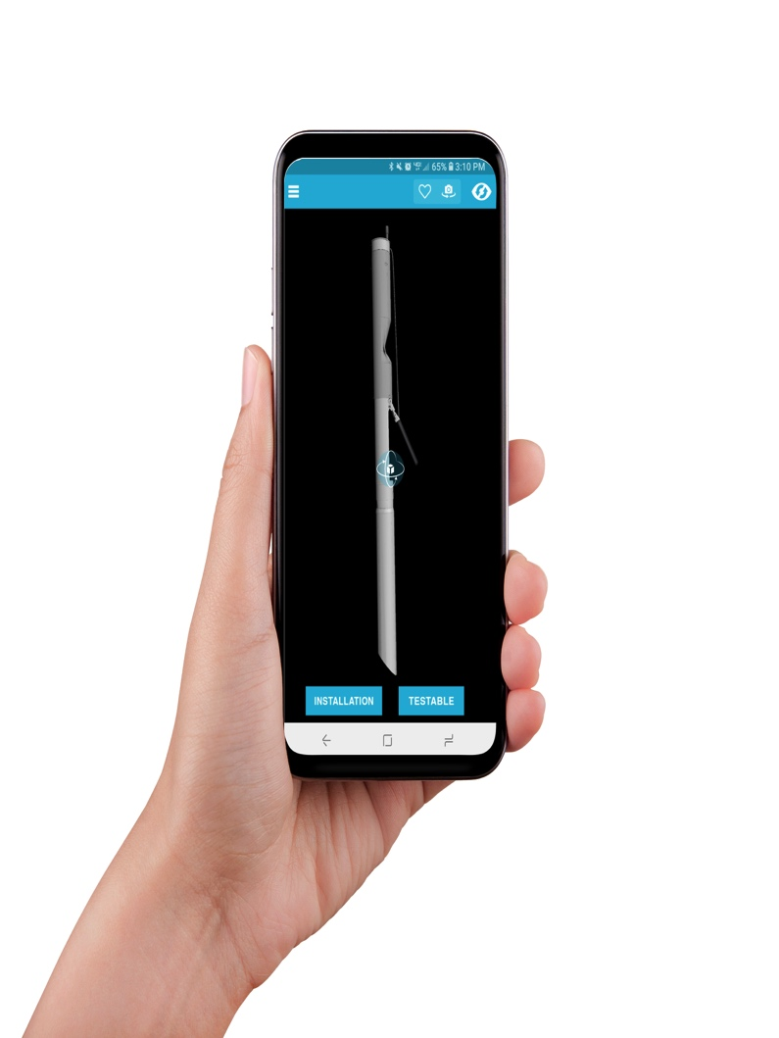

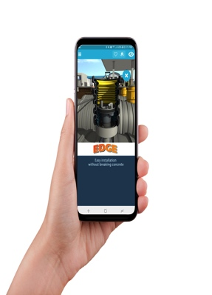
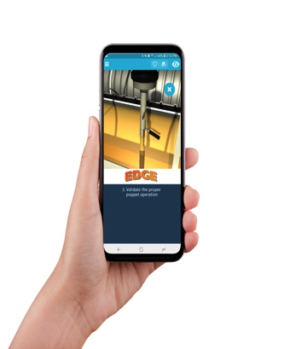
Augmented Reality
Tradeshow Flyer
Cutaway View
U Channel Detail

Slide 8

Easy, Affordable & EPA Compliant
To request more information:
Contact your OPW District Manager
Call OPW Customer Service at 800-422-2525
Visit us at www.opwglobal.com.

Slide 9
Thank You!

