Slide 1
No Drill.
Wire Ready.
Watertight.
ElectroTite. No Drill Dry Sump Technology.

Slide 2
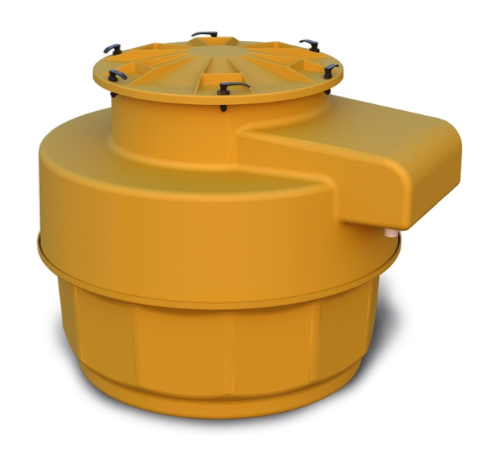

Watertight Wonder
From the engineering labs of FLEXWORKS and FIBRELITE, OPW has made the best even better.
Meet the newest member of the FibreTite Family of sumps,
the most watertight sumps on the market today.
Designed to meet all the new 2018 EPA UST regulations

Slide 3
Watertight Wonder
Eliminates electrician cutting holes in sump
Easy inspection without entering confined sump area
Available in a wide variety of models to accommodate virtually any tank sump application
Kwik Wire™* junction box allows for high voltage STP and low voltage sensor wires in same box. Sealed conduits above water table
No conduit entry fittings
*Patent Pending

Slide 4

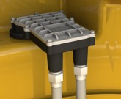
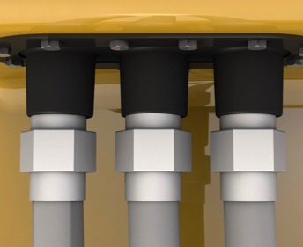
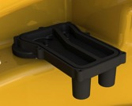
Unique Feature Set
Factory Installed
No On-Site Drilling*
*Patent Pending
Conduit Threads
On Outside of Box*
*Patent Pending
UL Listed Explosion-
Proof Junction Box*
*Patent Pending

Slide 5
Unique Feature Set
33" and 37" Lid for Turbine Sump
or Spill Platform For Multiport
Top Hat Trims down for 12.5"
Height Adjustment
42" or 48" Collar Mount or
Solid Base Attachment

Slide 6
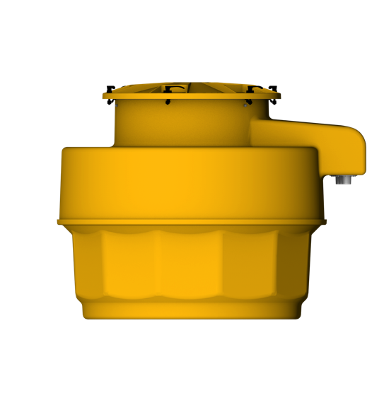
Ordering Specifications
Sump Lid Diameter:
33" or 37"
Model Number | Sump Base Diameter | Max Sump Height | Minimum Sump Height | Sump Mount Design | Sump Lid Diameter | Minimum Diameter Opening | # of Conduit Boxes
FCSM-1-4233CR | 42" | 46" | 39" | Collar Ring Mount | 33" | 29" | Single
FCSM-1-4233SB | 42" | 46" | 39" | Solid Bottom | 33" | 29" | Single
FCSD-1-4233CR | 42" | 53" | 47" | Collar Ring Mount | 33" | 29" | Single
FCSD-1-4233SB | 42" | 53" | 47" | Solid Bottom | 33" | 29" | Single
FCSM-2-4233CR | 42" | 46" | 39" | Collar Ring Mount | 33" | 29" | Dual
FCSM-2-4233SB | 42" | 46" | 39" | Solid Bottom | 33" | 29" | Dual
FCSD-2-4233CR | 42" | 53" | 47" | Collar Ring Mount | 33" | 29" | Dual
FCSD-2-4233SB | 42" | 53" | 47" | Solid Bottom | 33" | 29" | Dual
FCSM-1-4837CR | 48" | 46" | 39" | Collar Ring Mount | 37" | 34.6" | Single
FCSD-1-4837CR | 48" | 53" | 47" | Collar Ring Mount | 37" | 34.6" | Single
FCSM-2-4837CR | 48" | 46" | 39" | Collar Ring Mount | 37" | 34.6" | Dual
FCSD-2-4837CR | 48" | 53" | 47" | Collar Ring Mount | 37" | 34.6" | Dual
Sump Height:
46" or 53"
Mount Design:
Collar Mount Solid Base Reverse Flange
Base Mount Diameter:
42" or 48 inches"

Slide 7
Ordering Specifications – Replacement Parts

Slide 8
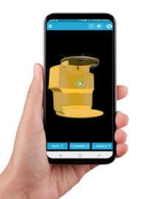
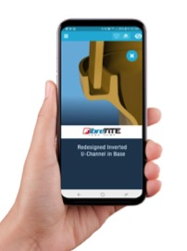
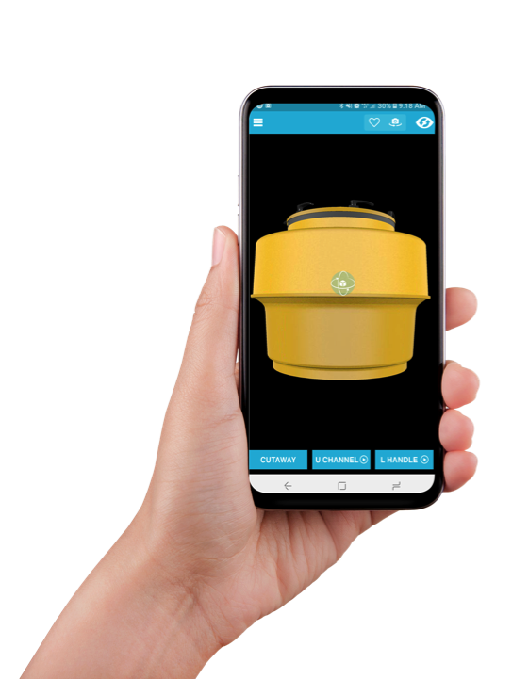
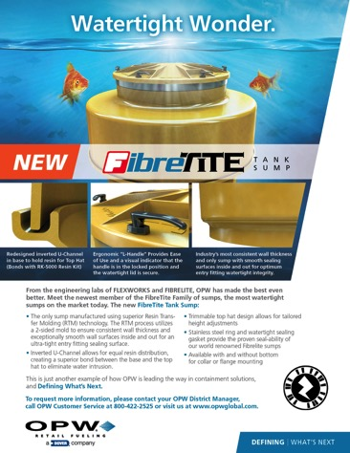
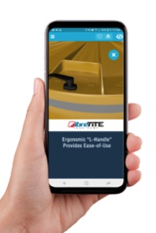
Augmented Reality
Tradeshow Flyer
Cutaway View
U Channel Detail
L Handle Detail

Slide 9
Watertight Wonder
To request more information:
Contact your OPW District Manager
Call OPW Customer Service at 800-422-2525
Visit us at www.opwglobal.com.

Slide 10
Thank You!

