Slide 1
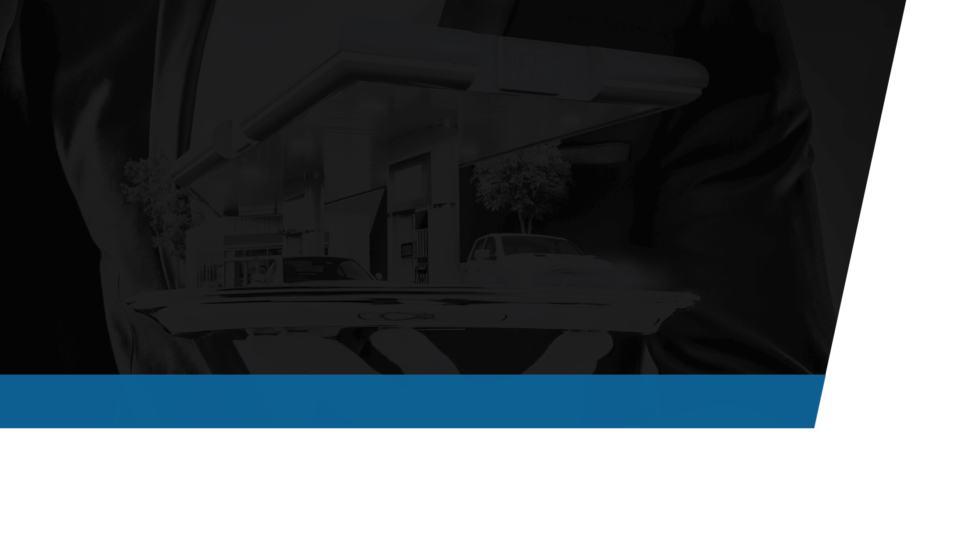
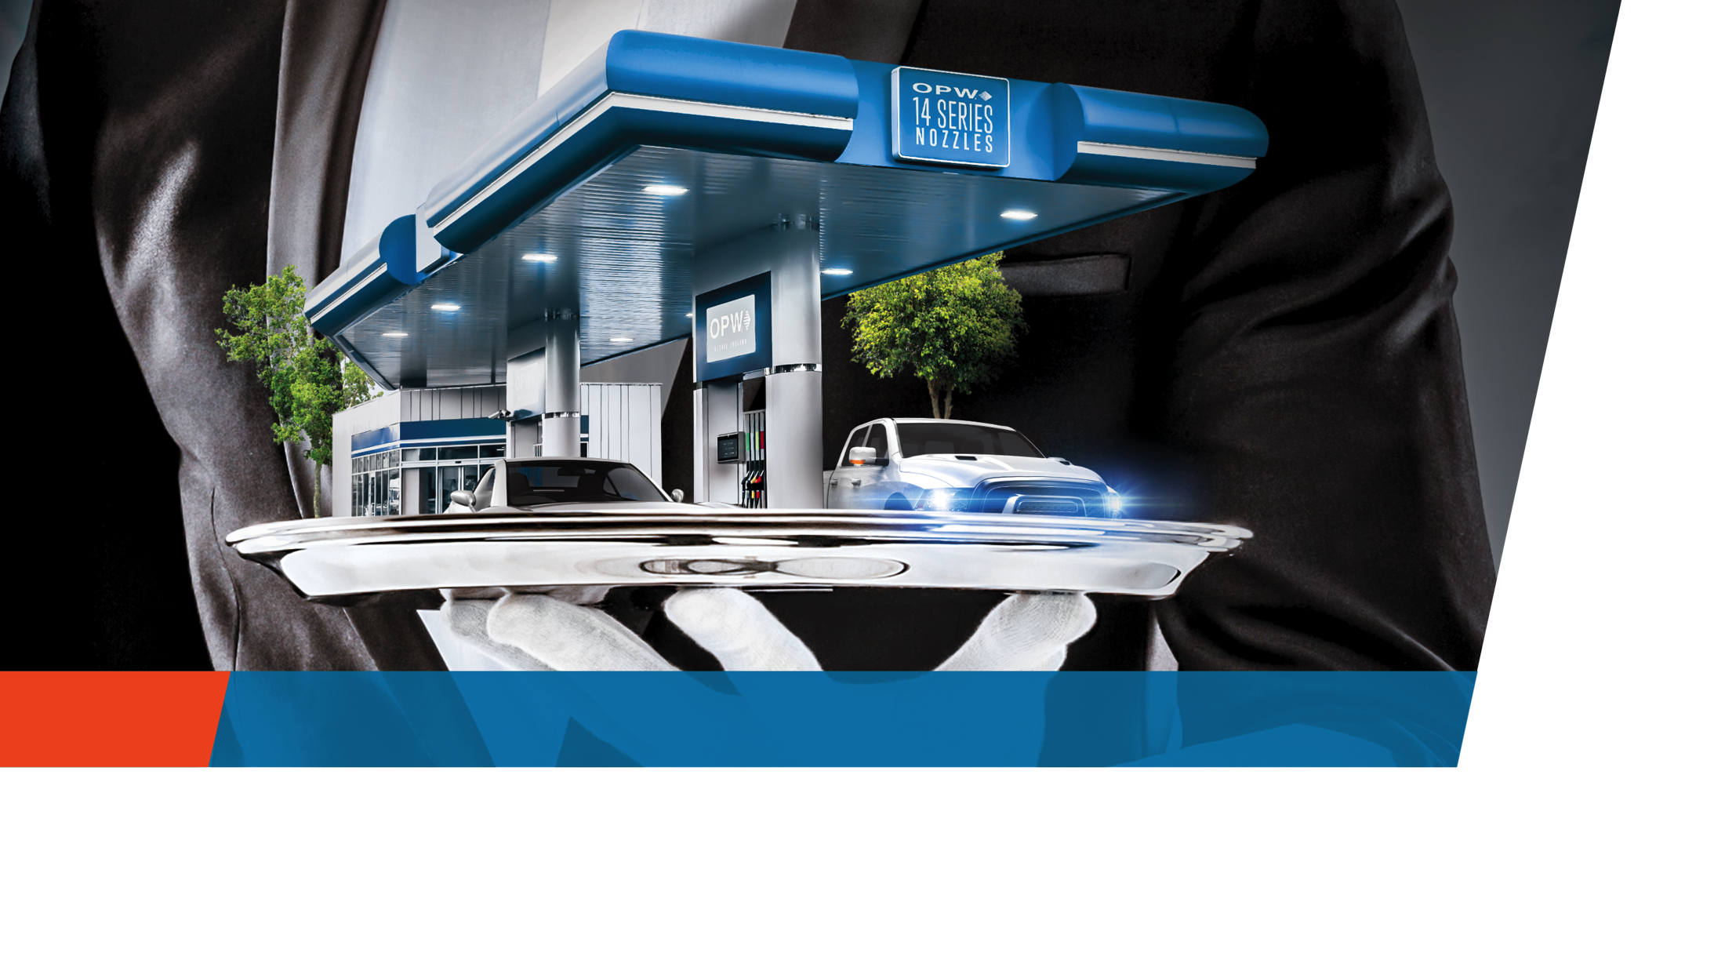
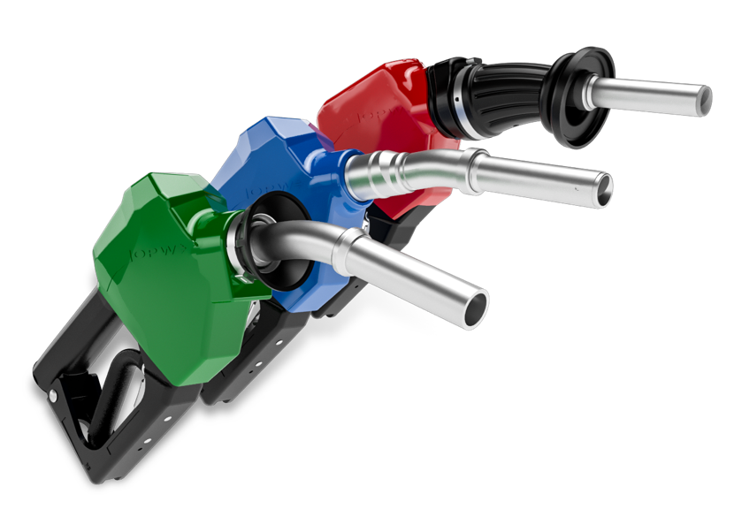
Give Your
Station a Spotless
Reputation
NEW
OPW 14 Series Nozzles
Cleaner Nozzle Technology

Slide 2
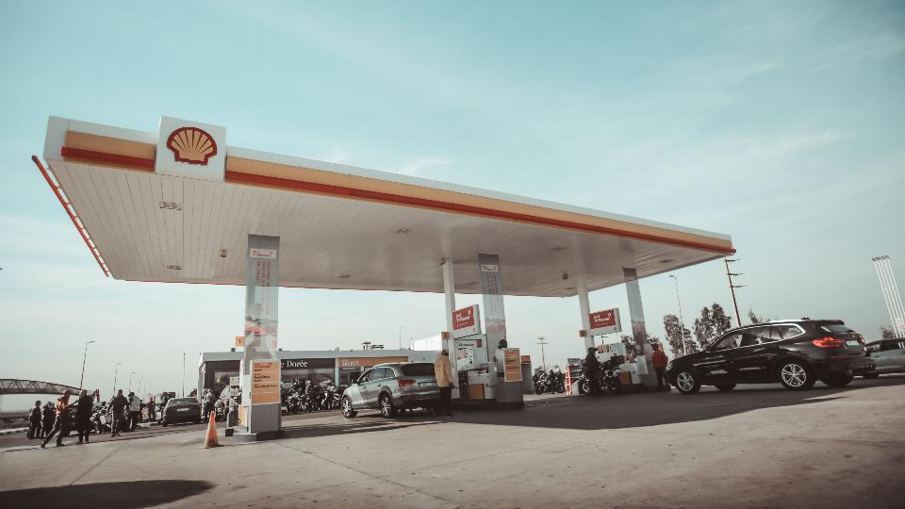
Gasbuddy Survey:
What factors have an influence on your opinion of a store before stepping inside?
79.7% said “Cleanliness of the fueling area”
Conversion from fuel-only to inside customers depends on a c-store’s ability to meet consumer needs of safety, cleanliness, and hospitality.

Slide 3
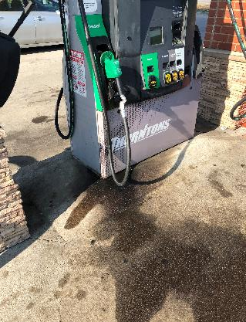
This is where OPW can provide value

Slide 4
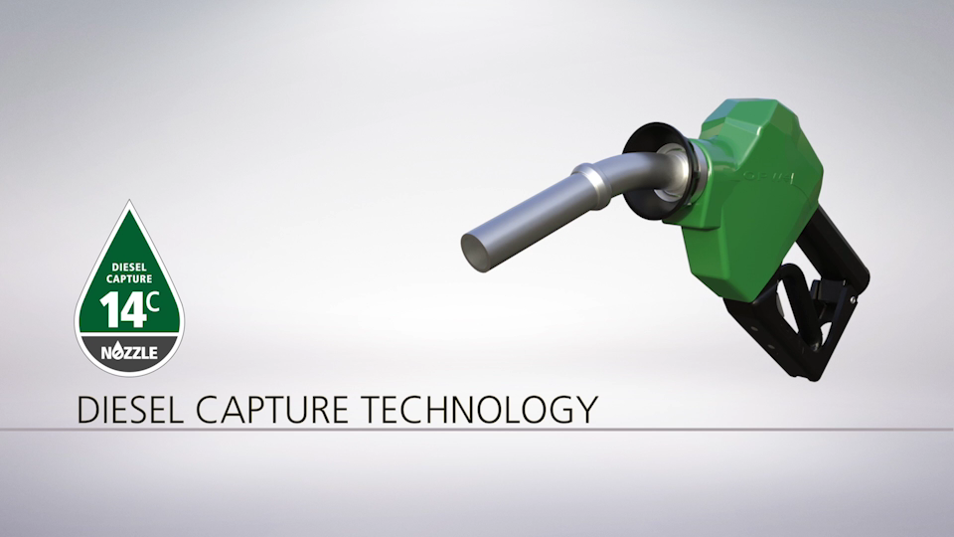
How the 14C Creates Clean
14C Video Animation (please click below)

Slide 5
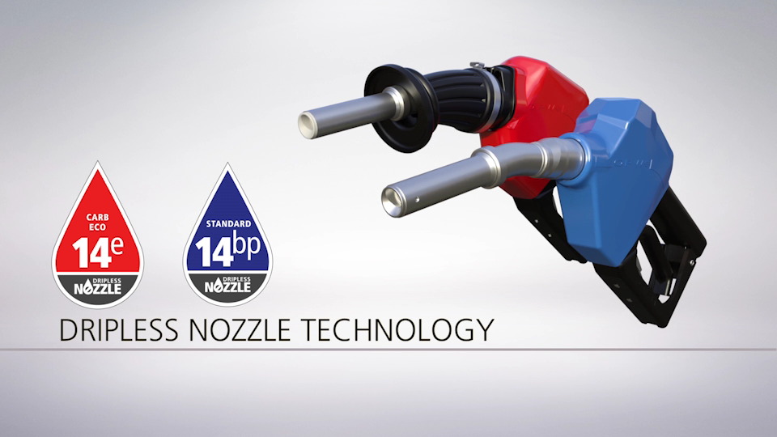
14BP & 14E Dripless Nozzle Technology
14E Video Animation (please click below)

Slide 6
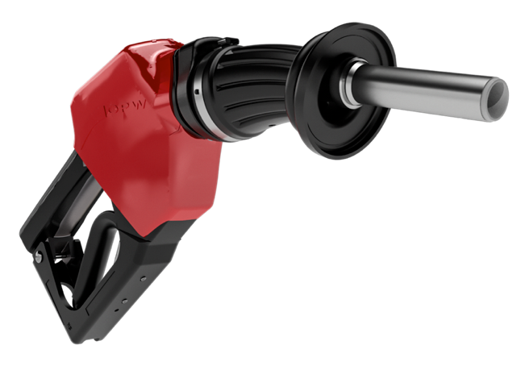

14E Enhanced Conventional Nozzle
Dripless Diesel Fueling
True Dripless Gasoline Nozzle
Patented Free-Draining Technology
  No Liquid Catching Surfaces
UL/ULC approved
CARB approved, with interlock
Initiative

Slide 7
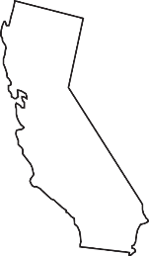

Where the 14E is…
Required
NJ
CA
Other states requiring CARB approved dripless conventional nozzle when decommissioning Stage II
*Sites with 100% ORVR vehicles

Slide 8

CARB Requires an Interlock on Nozzles
3.4 Insertion Interlock
  Each ECO Nozzle shall have an insertion interlock designed to prevent the dispensing of fuel unless there is an indication that the nozzle is engaged in the fill pipe.

Slide 9
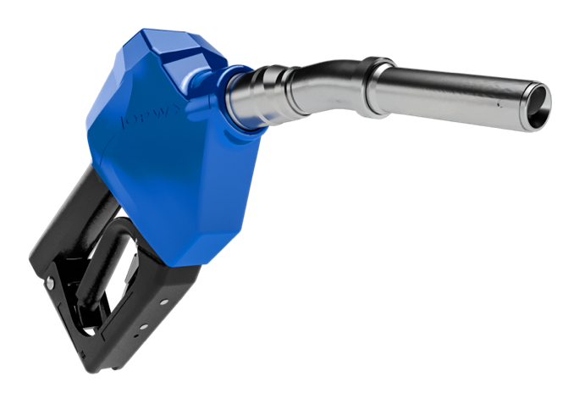
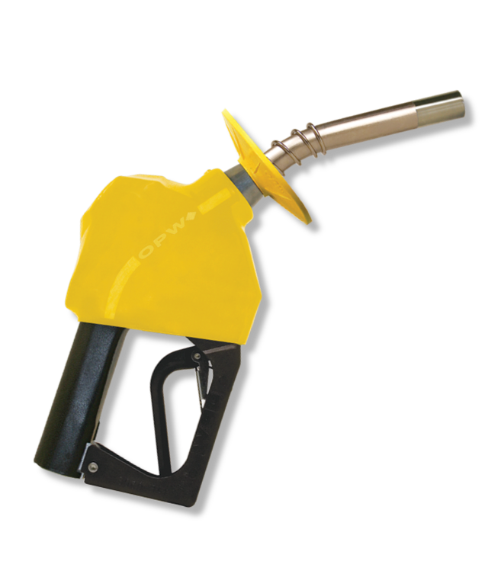
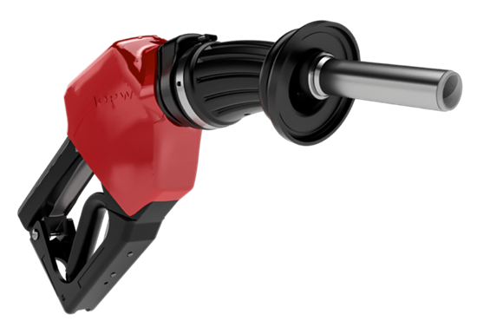

+
=
14E Spout
11BP Body
14BP Automatic Dripless Nozzle
True Dripless Gasoline Nozzle
Patented Free -Draining Technology – No Liquid Catching Surfaces
cULus Listed
No Interlock

Slide 10

14BP Automatic Dripless Nozzle
True Dripless Gasoline Nozzle
Patented Free-Draining Technology
  No Liquid Catching Surfaces
No Interlock
No Pressure / No Flow
Cannot be CARB approved
UL/ULC approved
Now UL Listed for up to E25

Slide 11
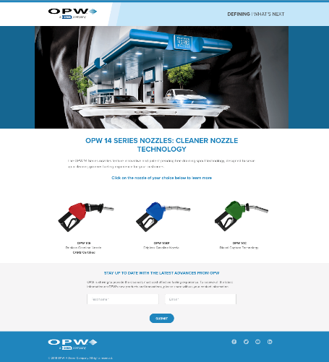
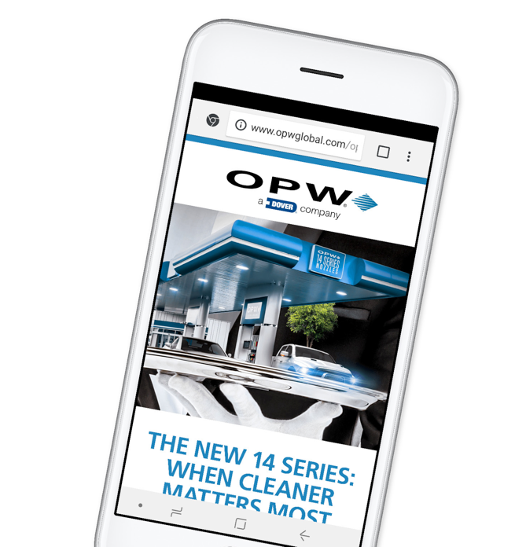
Learn How the New
14 Series Nozzles
Can Give Your Site a Spotless Reputation
Download all the details you need and give us a call today
VISIT US AT:
opwclean14.com

Slide 12
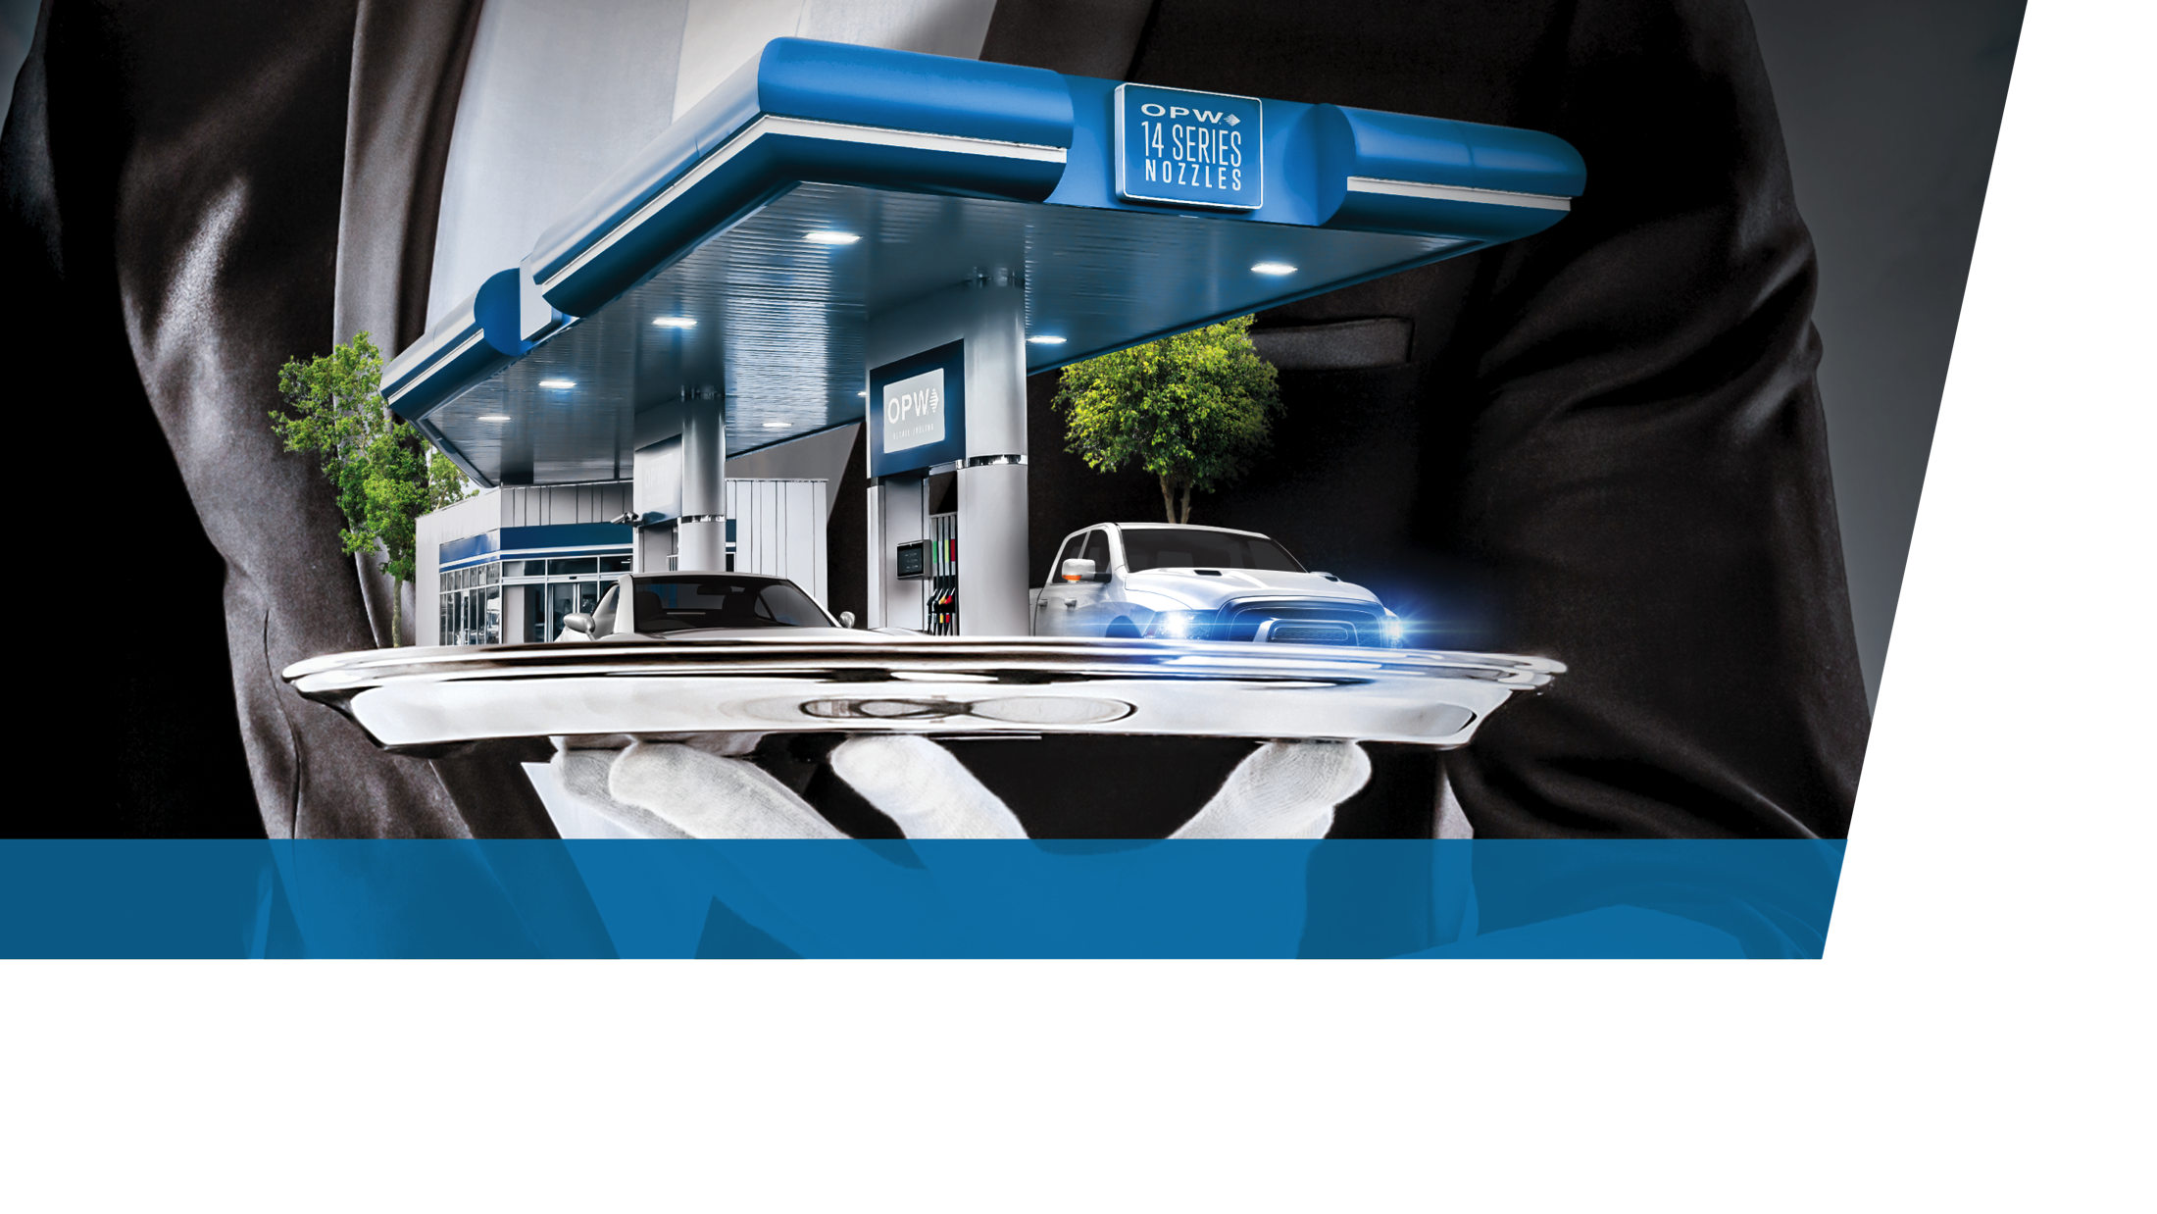
Thank You!
Brenton Hershner – Brenton.Hershner@opwglobal.com
Direct: (513) 870-3168

