Slide 3
Made with Advanced Composite Technology
Smooth sides
Consistent wall thickness, material blend and shape every time
Designed to minimize parts inventory
Innovated for nesting to reduce space needed for storage
Compatible with all industry fittings and pipe

Slide 4
In stock and ready to ship
Shortest lead times of any dispenser sump in the industry

Slide 5
Value priced to bring OPW quality and service to everyone
Affordability without sacrificing quality or speed

Slide 6
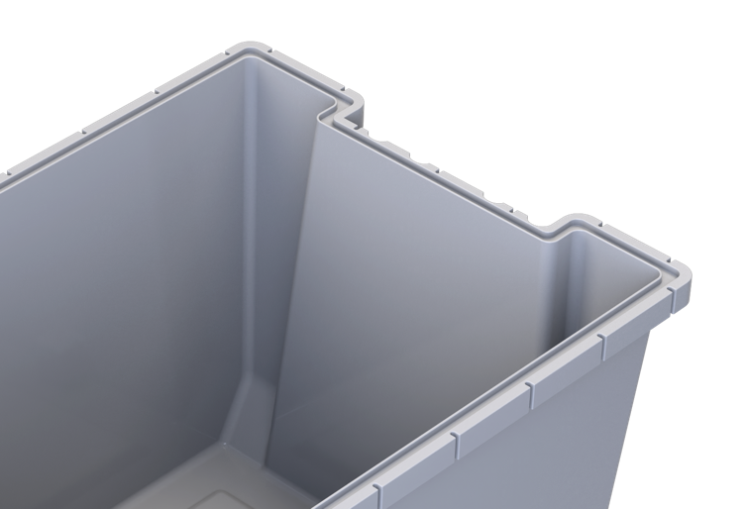
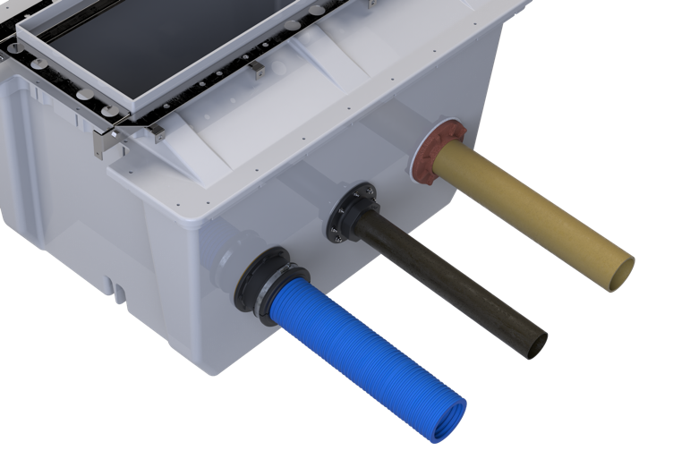
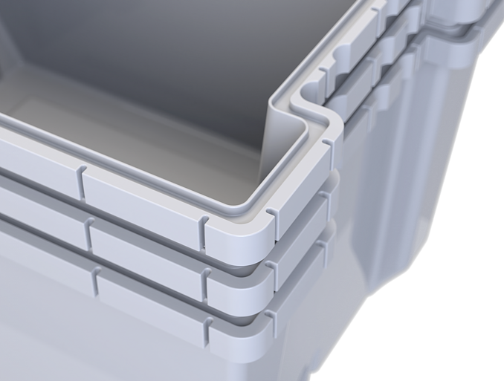
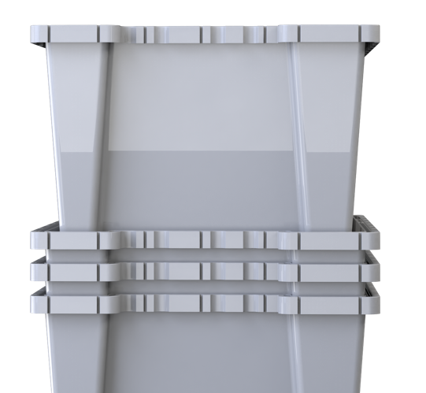
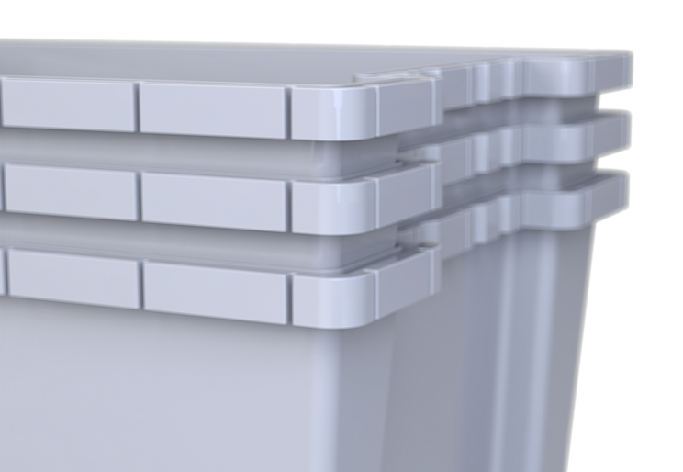
The only product in the Retail Fueling industry made with Advanced Composite Technology for the highest quality results
Completely smooth on the interior and exterior for an enhanced leak-resistant sealing surface
The universal DSE dispenser sump base works with all industry fittings as well as fiberglass and flexible pipe.
Advanced Composite Technology produces a perfect, robust product every time without exposing workers or the environment to resin vapors and glass fibers
Specifically designed with features that allow sump bases to nest together to minimize shipping costs and maximize space in warehouses, trailers and on job sites
The efficiencies of Advanced Composite Technology means the DSE is available with the shortest lead times in the industry, and at a price that is accessible to everyone.

Slide 7
Robust Construction
The DSE is made with the highest-quality manufacturing process and premium finishes that are consistent on every sump
Any Pipe, Any Fitting
The DSE seamless works with fiberglass pipe, flexible pipe, and any industry fittings
Stacked with Features
The DSE incorporates features that allow multiple sumps to nest together and unstack with ease

Slide 8
The DSE features unique design elements that make the universal bases stack together while also allowing for easy unstacking.
It was designed to minimize your shipping costs and maximize space in distributor warehouses, in construction trailers, and on job sites.

Slide 10
Gilbarco Encore
DSE-1836
Wayne Ovation
DSE-1543
Wayne Helix
DSE-1741

Slide 11
Universal Base
DSE-BASE
Gilbarco Encore Top
DSE-TOP-1836
Wayne Helix Top
DSE-TOP-1741
Wayne Ovation Top
DSE-TOP-1543

