Slide 1
OPW’s SiteSentinel® Nano®
Overview, Features and Benefits

Slide 2

Product Introduction
The SiteSentinel® Nano® tank gauge provides
simple, accurate and affordable inventory management.
User-Friendly: Intuitive software makes the Nano simple-to-use.
Versatile: The Nano’s small size makes it is ideal for any site.
Convenient: Remote Accessibility Streamlines Your Daily Workflow.
Affordable: A Competitive Fixed Price and no maintenance fees make the Nano an economical gauge.

Slide 3

Key Benefits
The SiteSentinel® Nano® is
Simple to Use
The Nano’s icon-based software was developed for ease-of-use
Remote accessibility makes interacting with the gauge from anywhere possible
Conduct training and
access direct
technical support
remotely

Slide 4

Key Benefits
The SiteSentinel® Nano® is
Affordable yet Reliable
The Nano’s list price is lower than most comparable competitive alternatives
OPW’s advanced technology ensures accurate inventory,
alert and leak-detection data
Multi-drop technology
substantially reduces
installation costs
Remote accessibility allows
for a reduction in monitoring
labor and training costs

Slide 5

Key Benefits
The SiteSentinel® Nano® is
Easy to Install
Comes out of the box fully functional
Small equipment footprint
is ideal for tight spaces
Multi-drop technology minimizes site
wiring infrastructure and installation labor
REDUCE INSTALLATION
Wire
Labor
Conduit

Slide 6
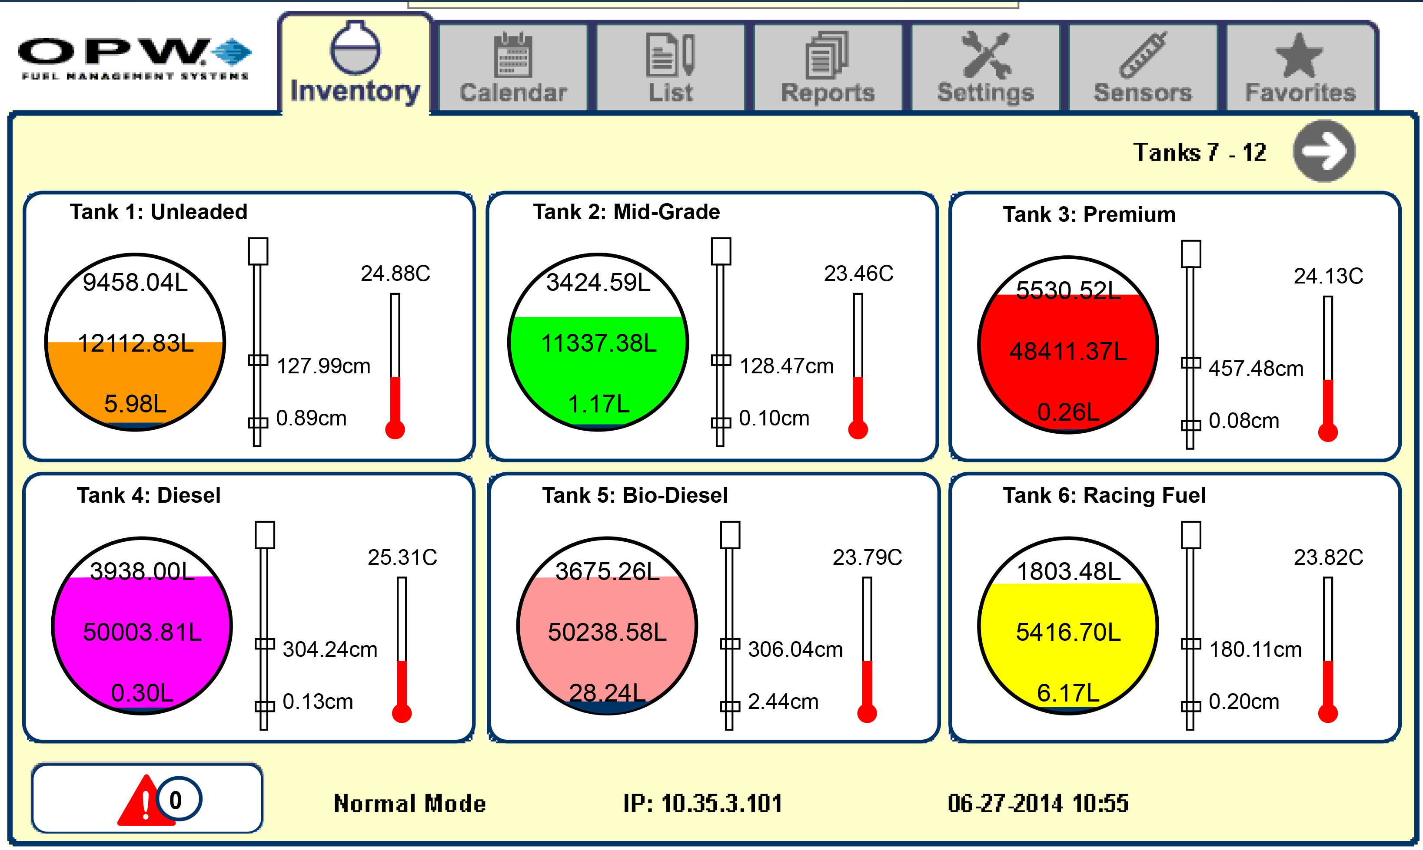
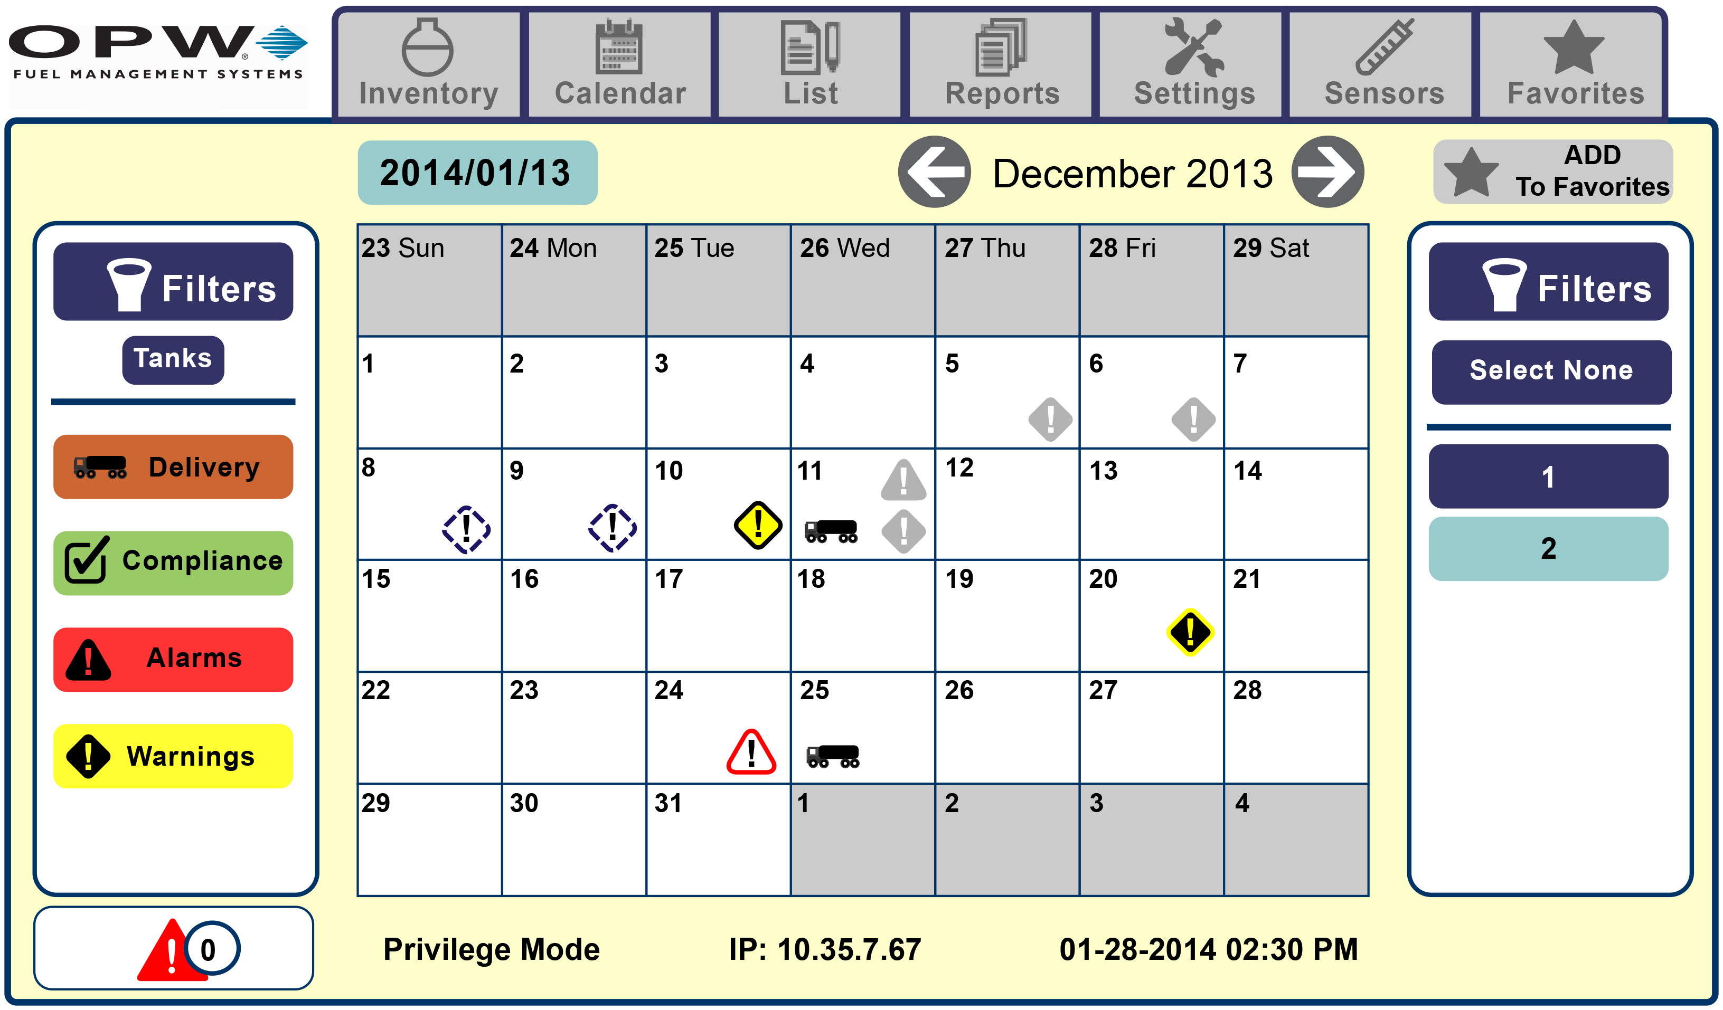
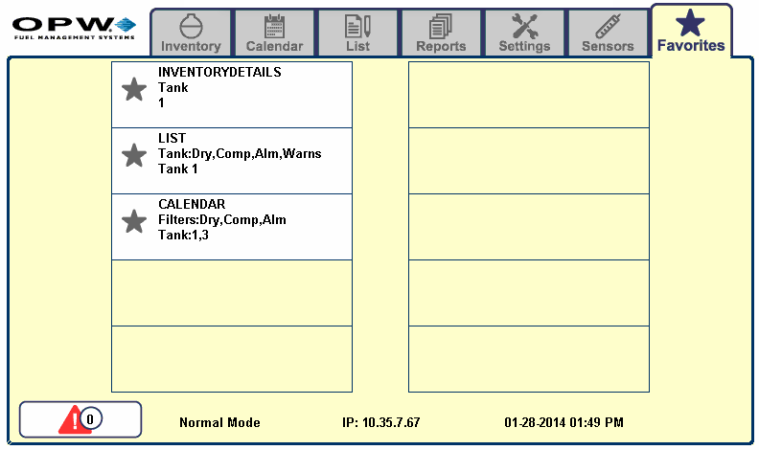
Features and Specifications
Software Functionality
Tank View
Shows up to moment inventory, water and temperature data for each of your tanks.
Calendar View
Allows you to easily see your alarms, alerts and deliveries, and when they occurred, on a day-by-day basis.
Favorites View
Shows a list of your most common exception and event filter settings.

Slide 7
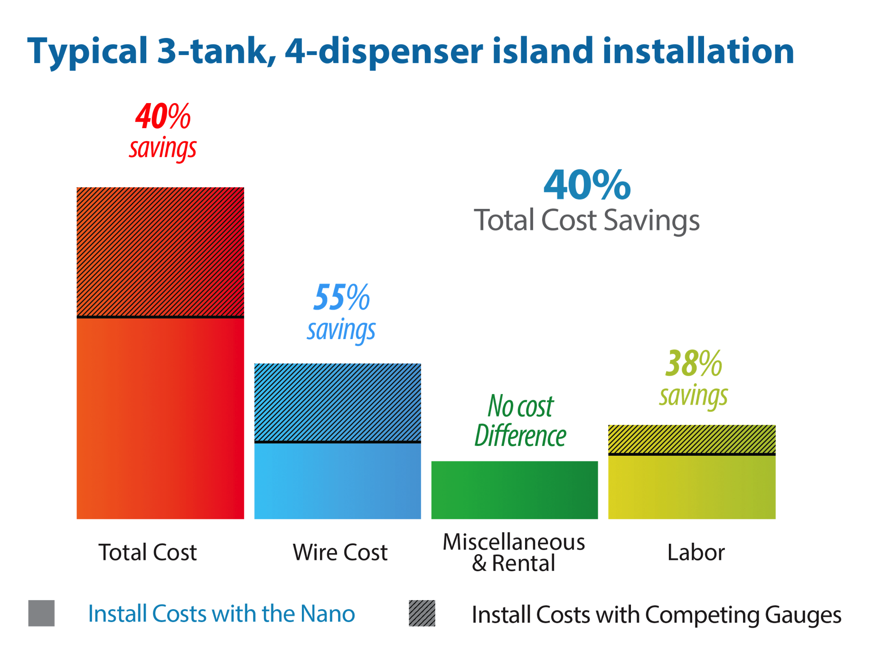
Features and Specifications
Multi-Drop Technology
Multiple probes and sensors
can be run back to the gauge on wire
Reduces amount of wiring
needed for a significant savings
on wire expenses
Less wiring makes for a less
labor intensive installation
Decreases site downtime
needed for gauge
installation or maintenance

Slide 8
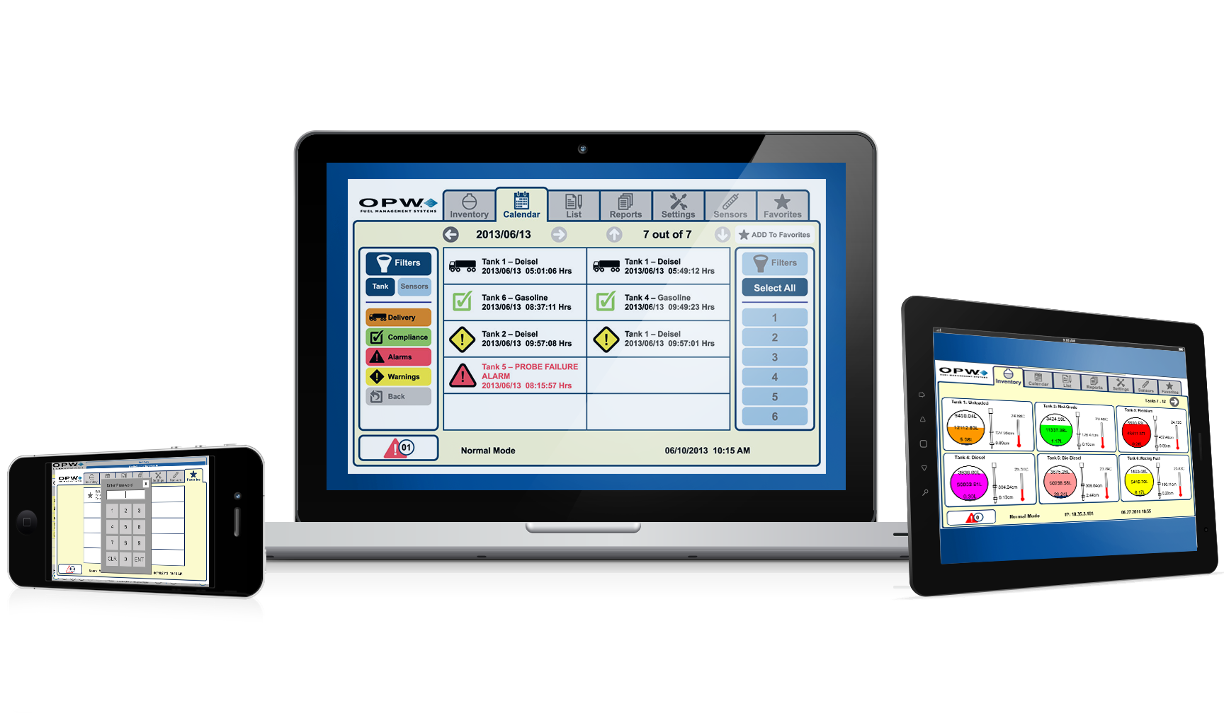
Features and Specifications
Remote Accessibility
Access data and interact with the gauge, from anywhere, on most devices
Facilitate remote
training programs and processes
Remote Support technicians can troubleshoot problems in real time
Software updates and upgrades can
be implemented remotely

Slide 9
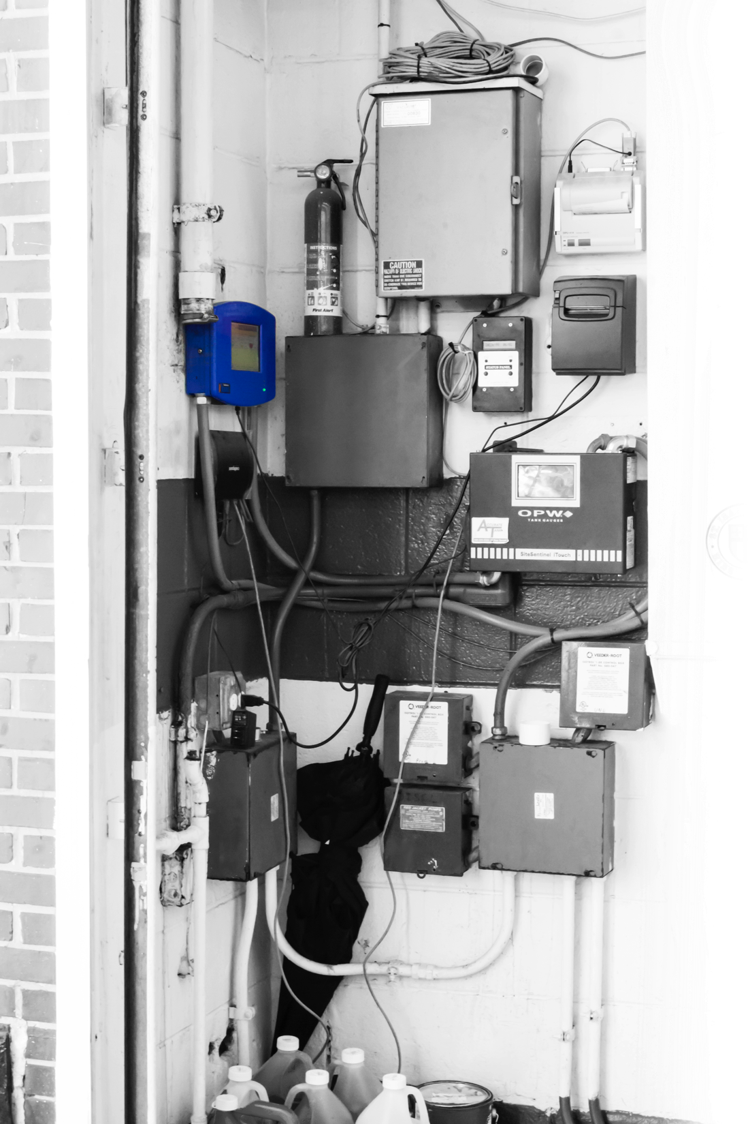
Features and Specifications
Small Equipment Footprint
Console’s small profile makes it ideal for tight spaces
Provides the flexibility to be placed where ever is most convenient for access
Accommodates 12 probes and 24 sensors making the small gauge capable of monitoring larger sites
Despite it’s small footprint, the gauge boasts a user-friendly 18cm (7”) touchscreen

Slide 10
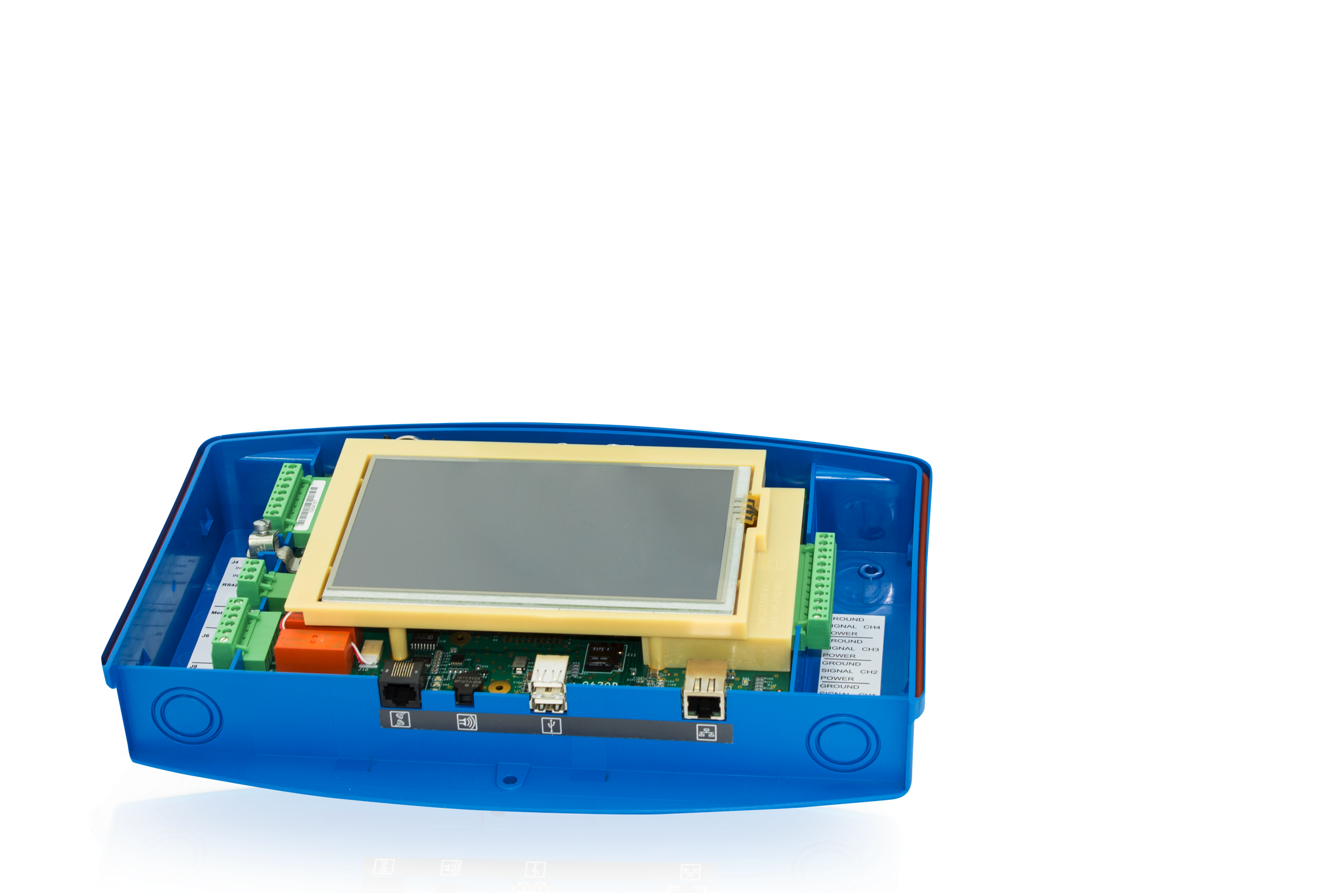
Features and Specifications
Dimensions and Display:
2 1 c m H x 3 2 . 5 c m W x 6 c m D
18 (7”) cm color LCD touchscreen display
Graphical user interface
Operating Requirements:
Power: 120/240 VAC +/- 10%, 50/60 Hz, 20 W
Operating Temperature Range: 0°C to 50°C
Alarms:
Standard Alarms: Buzzer, Light and Acknowledge
Optional Alarms: External Tank Alert (internal relay)
Reporting:
Alarm Notifications: Email, Fax, SMS
Printer: External USB
Connectivity and Communication Ports:
Network Connectivity: DHCP/static addressable RJ-45 Ethernet ports, supports corporate and local LANs
Communication Ports:
  One (1) RS-232 Communication port
  One (1) RS-485 Communication port
  One (1) RS-422 Communication port
  One (1) Ethernet port
  Two (2) USB ports
  Two (2) Internal inputs
  Two (2) Internal outputs

Slide 11
Q & A
Q
What kind of warranty coverage does the SiteSentinel® Nano® offer?
12 months from date of installation or 18 months from manufacturer’s shipment date. Upgrades and replacement parts are covered for 90 days from the date of installation or for the remainder of the system’s original warranty, whichever is greater.
Is there a Nano tank gauge option for users who will only interact with the interface remotely?
Yes. A “blank door” unit is available for sites that will only operate
the console through remote connections.
A
Q
A

Slide 12
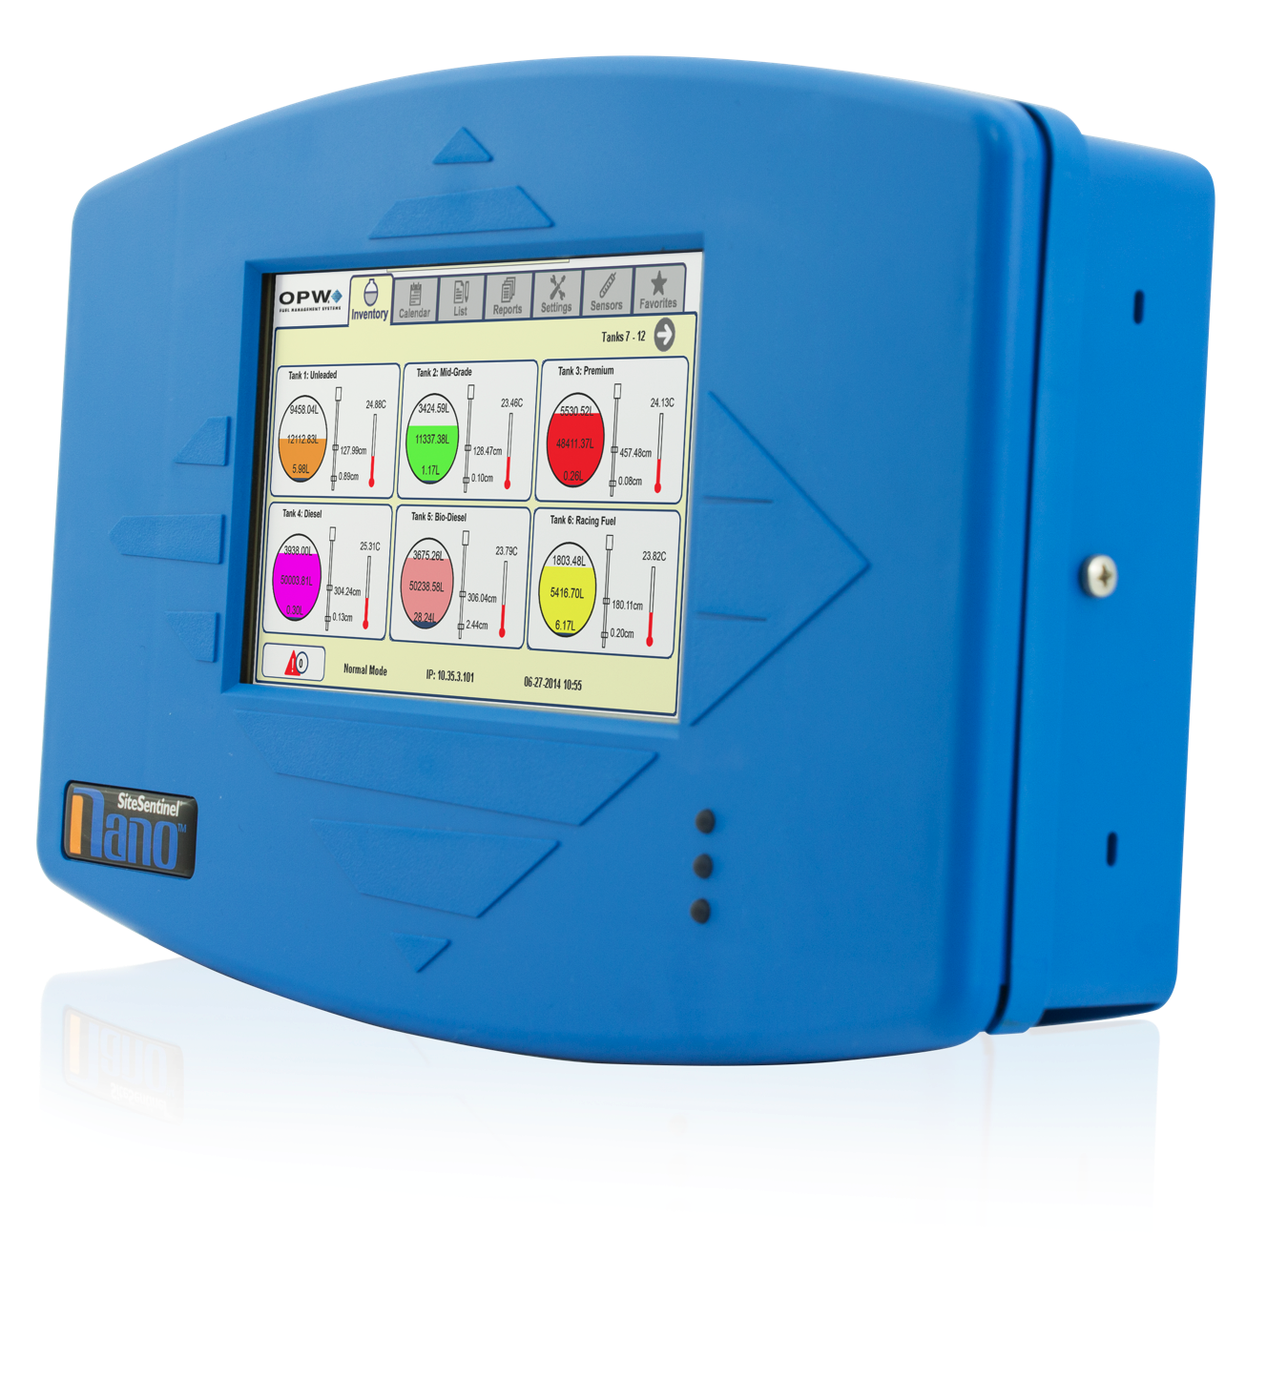
CONCLUSION
The SiteSentinel® Nano® tank gauge provides
simple, accurate and affordable inventory management.
User-Friendly:
The gauge’s interface
is easy to use.
Versatile:
The Nano is ideal
for any size site.
Convenient:
Gauge provides
remote accessibility.
Affordable:
The Nano comes at a competitive list price with no ongoing fees.

