Slide 1
OPW’s SiteSentinel® iTouch™
Overview, Features and Benefits

Slide 2
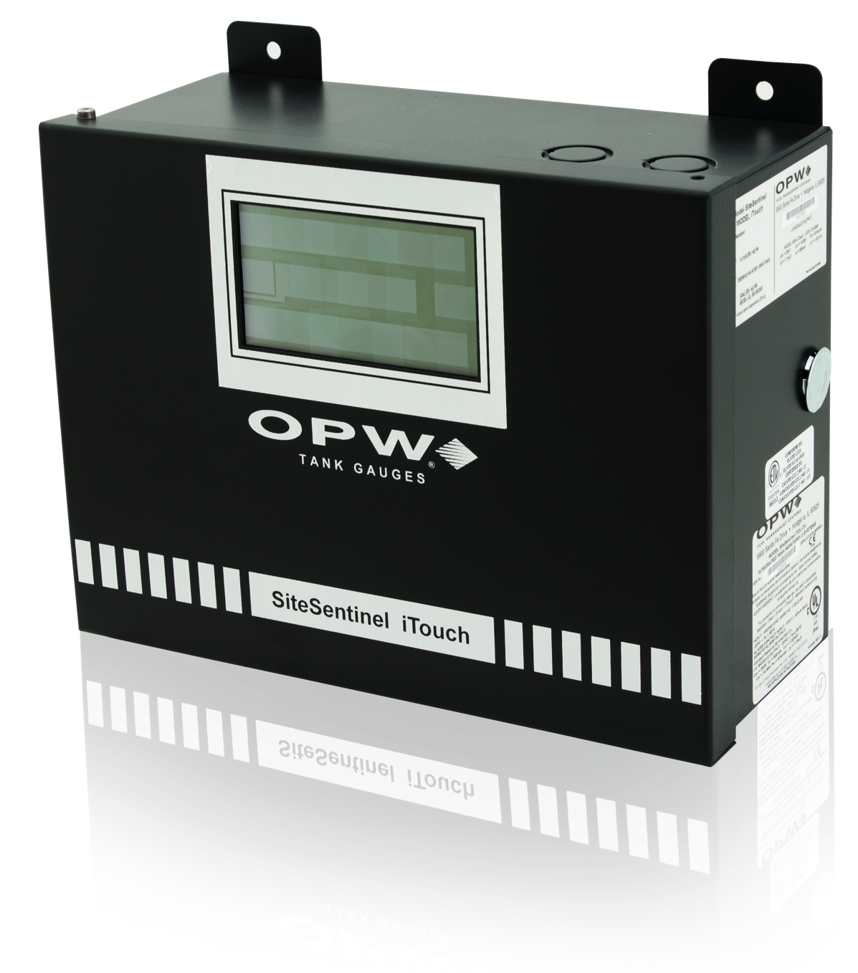
Product Introduction
The SiteSentinel® iTouch™ tank gauge provides
dependable and accurate inventory management in an economical and user-friendly console.
Affordable: A competitive price provides a cost-conscious option for fuel site operators with limited budgets.
Reliable: Proven, field-tested technology helps fuel site operators meet compliance requirements.
Precise: Real-time inventory data accurately communicates storage tank capacities, alarms and alerts.
Easy to Use: A graphic touchscreen and remote access software provide a user-friendly experience.

Slide 3
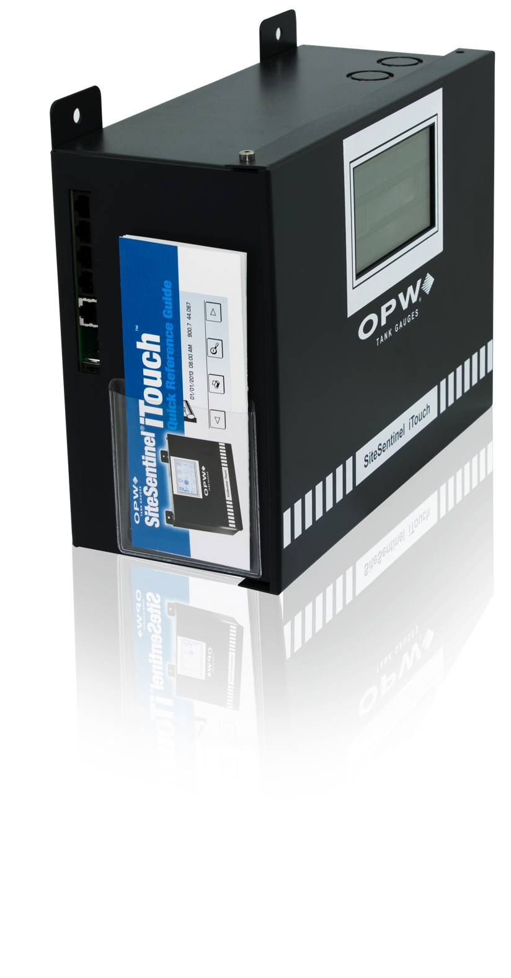
Key Benefits
The SiteSentinel® iTouch™ is
Economical yet Effective
The iTouch is offered at a price point that is lower than most competitive gauges
Budget-conscious console doesn’t compromise functionality for cost savings
PC remote-access software is included
System interfaces with most POS devices for reduced conversion costs

Slide 4

Key Benefits
The SiteSentinel® iTouch™ is
Convenient and User-Friendly
Features familiar Windows® software
Console offers a graphic touchscreen
display with easy-to-identify icons
System features automated
programming for reduced
user interaction
Console’s configuration can
be modified remotely

Slide 5
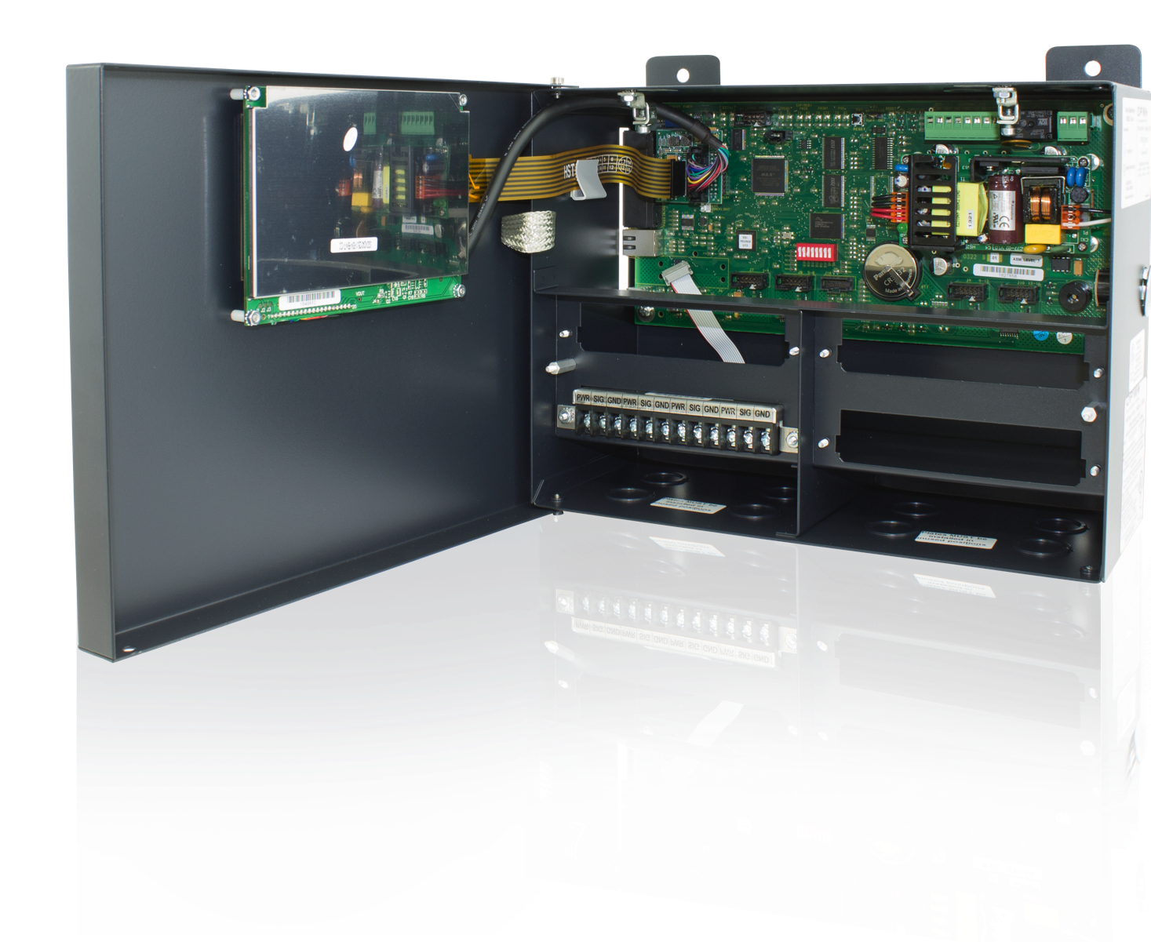
Key Benefits
The SiteSentinel® iTouch™ is
Customizable and Expandable
PV4 POS protocol can be
modified to meet the user’s needs
Enables future system expansion
through increased memory size
Fuel site data can be exported for
use with most major business
utility software

Slide 6
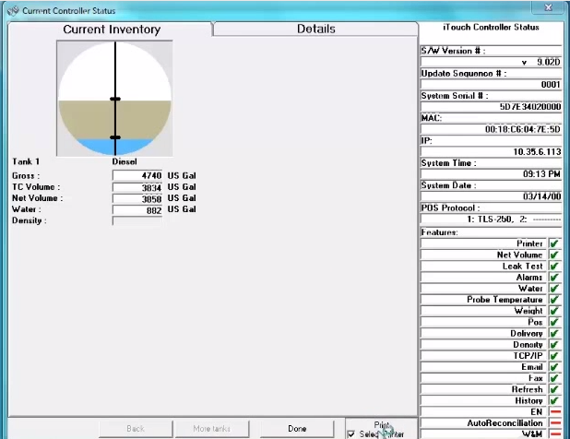
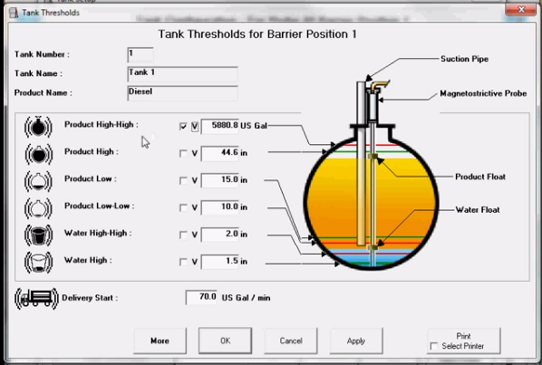
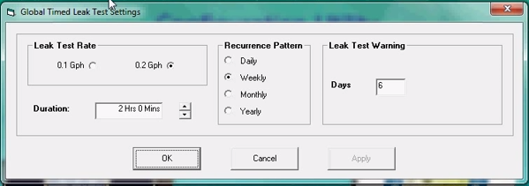
Features and Specifications
Software Functionality
Windows®- based SiteConnect™
makes site configuration easy
Compatible with SmartTalk® software
for enhanced business management
and compliance reporting
Automatic Leak Detection can be
pre-programmed to perform daily,
monthly, and annually required leak tests

Slide 7
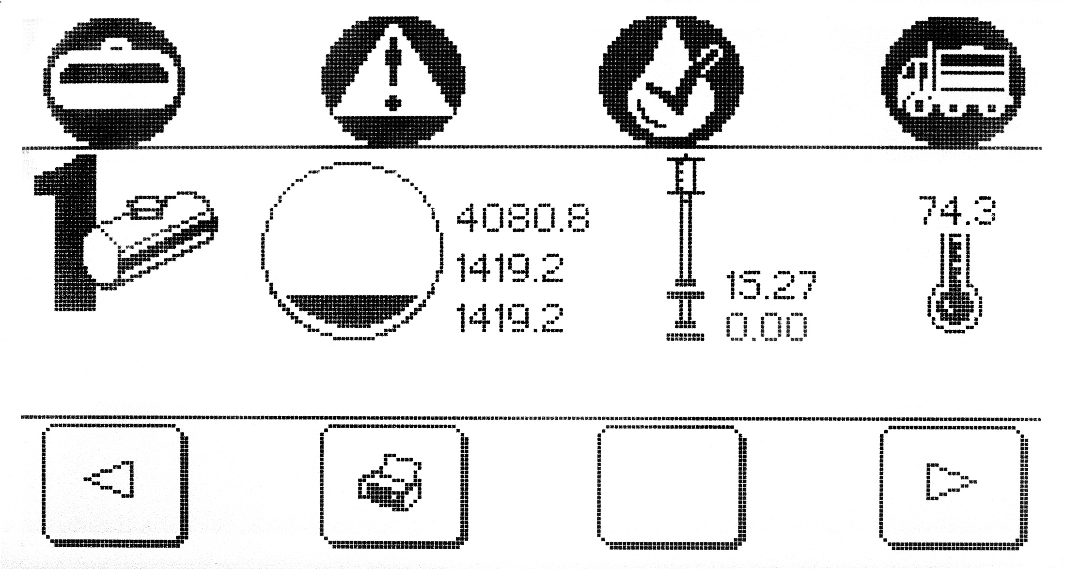
Features and Specifications
Compliance Assistance
Certified leak detection meets or exceeds U.S. EPA regulatory requirements
Automatic Leak Detection performs government-mandated leak tests
System can automatically
email alarms and events

Slide 8

Features and Specifications
Precision Inventory Data
Monitors up to 16 probes or sensors that can be connected in any combination
A graphic display provides real-time inventory data, delivery status, alarm conditions and leak-detection information
System provides more than 400 correction factors to help ensure an accurate tank chart

Slide 9
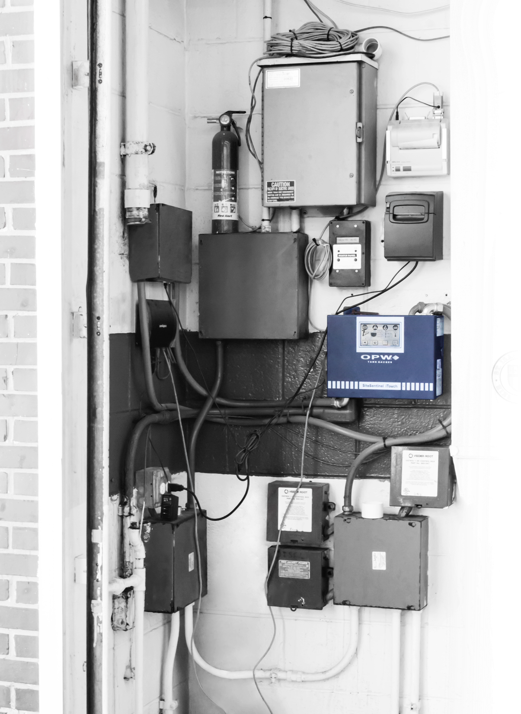
Features and Specifications
Reporting Management
Inventory, delivery, alarm and leak reports are available at a touch
Reports can be printed on the iTouch™ external printer or from SiteConnect™ on a PC printer
Reports can be configured to meet localized settings (date/time formats and metric/English units)

Slide 10

Features and Specifications
Dimensions:
9.3” H x 12.3” W x 5.2” D (23.5 cm H x 31.1 cm W x 13.3 cm D)
Console Operating Temperature Range:
1 4 °F t o 1 2 2° F (-1 0 ° C to 5 0 ° C )
Power Requirements:
Input Power: 100-250 VAC, 50/60 Hz, 0.5 A
Input Contact: 12VDC, 40 mA max.
Output Contact: 30V AC/DC, 2A
Output Module Contact: 2A @ 120/240 AC, 2A @ 24VDC
Minimum PC Requirements:
Pentium® processor, 32 MB RAM
20 MB available hard disk space
Recommended PC screen resolution (800 x 600)
Windows 98®, Windows NT® (version SP4 and above), Windows 2000®, Windows XP®, Windows Vista®
External Printer:
System-powered, graphics
40-column thermal printer includes wall-mounted bracket and a 6 ft (1.8 m) cable
Printer Operating Temperature Range:
32° F to 104° F (0° C to 40° C)

Slide 11
Q & A
Q
What kind of warranty coverage does the SiteSentinel® iTouch™ offer?
12 months from date of installation or 18 months from manufacturer’s shipment date. Upgrades and replacement parts are covered for 90 days from the date of installation or for the remainder of the system’s original warranty, whichever is greater.
How many storage tanks can the SiteSentinel® iTouch™ monitor?
The tank gauge can monitor up to 16 storage tanks.
A
Q
A

Slide 12
CONCLUSION
The SiteSentinel® iTouch™ tank gauge provides
dependable and accurate inventory management in an economical and user-friendly console.
Affordable: A competitive price provides a cost-conscious option for fuel site operators with limited budgets.
Reliable: Proven, field-tested technology helps fuel site operators meet compliance requirements.
Precise: Real-time inventory data accurately communicates storage tank capacities, alarms and alerts.
Easy to Use: A graphic touchscreen and remote access software provide a user-friendly experience.

