Slide 1
OPW’s SiteSentinel® Integra™ 100 and 500
Overview, Features and Benefits

Slide 2
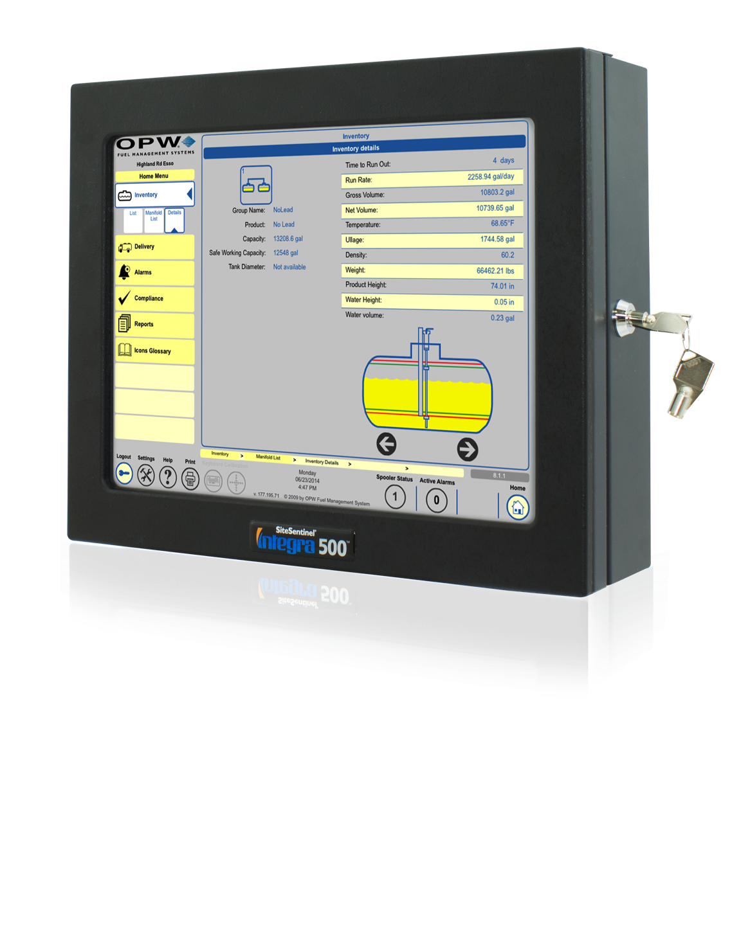
Product Introduction
The SiteSentinel® Integra™ 100 and 500 tank gauges deliver
comprehensive monitoring capabilities for inventory management.
Easy to Use: A graphic touchscreen and remote access software provide a user-friendly experience.
Versatile: Capable of monitoring up to 32 probes, the Integra is the ideal inventory management solution for even the largest fuel sites.
Economical: The Integra significantly reduces installation costs through multi-drop technology.
Upgradeable: The Integra 100 can be upgraded to the Integra 500 via a software update; the Integra 500 can be expanded through VSmart capability.

Slide 3
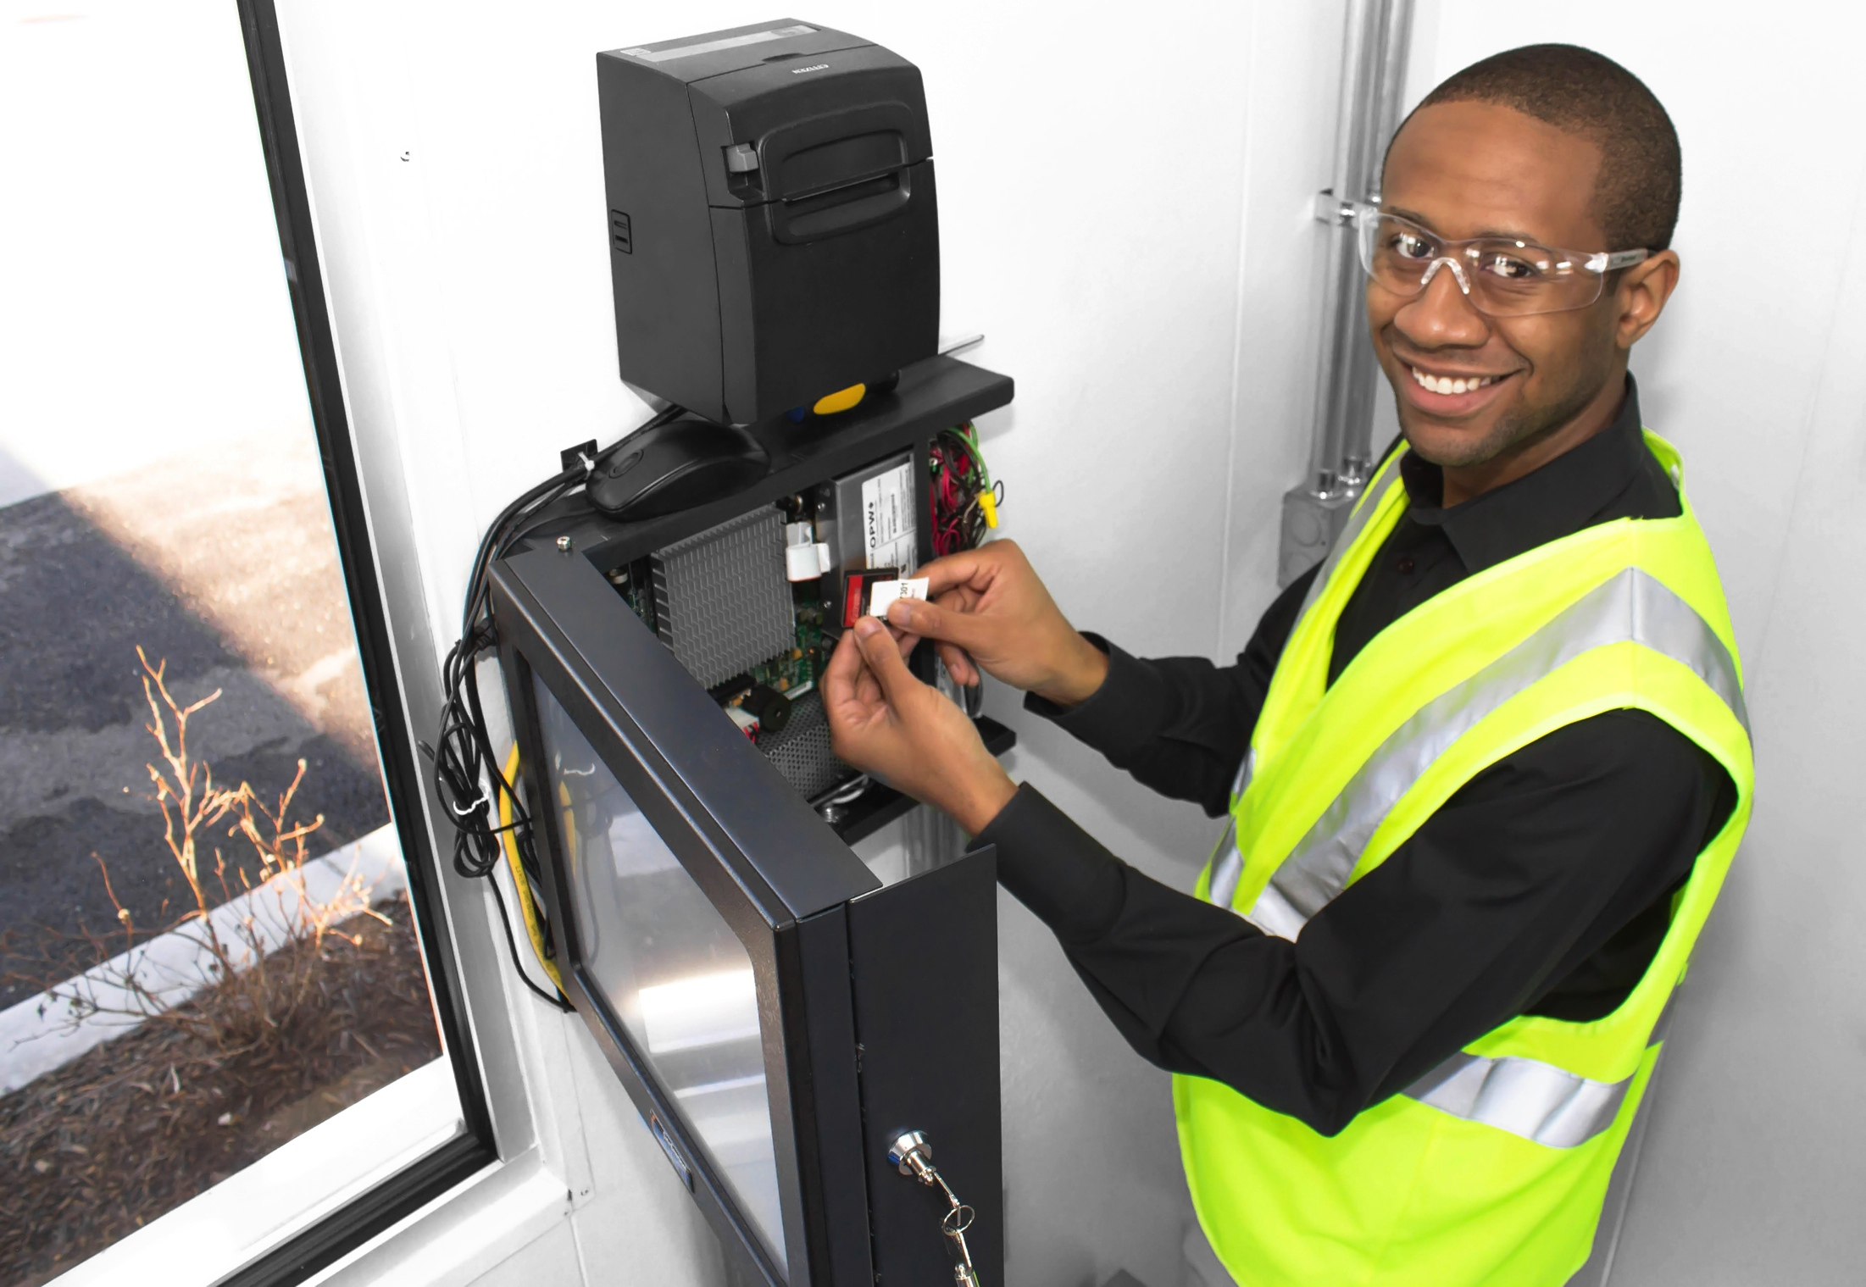
Key Benefits
The SiteSentinel® Integra™ 100 and 500 gauges are
User-friendly and Convenient
Features a large color touchscreen for one-touch access to critical inventory data
Remote accessibility makes interacting with the gauge from anywhere possible
Automated reporting requires less interaction from the user.

Slide 4
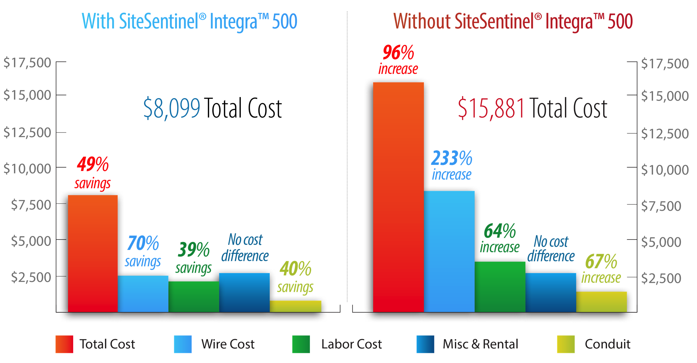
Key Benefits
The SiteSentinel® Integra™ 100 and 500 tank gauges are
Economical yet Effective
Multi-drop technology substantially reduces installation costs.
OPW’s advanced technology ensures accurate inventory, alert and leak-detection data
Remote accessibility allows for a reduction in monitoring labor and training costs

Slide 5
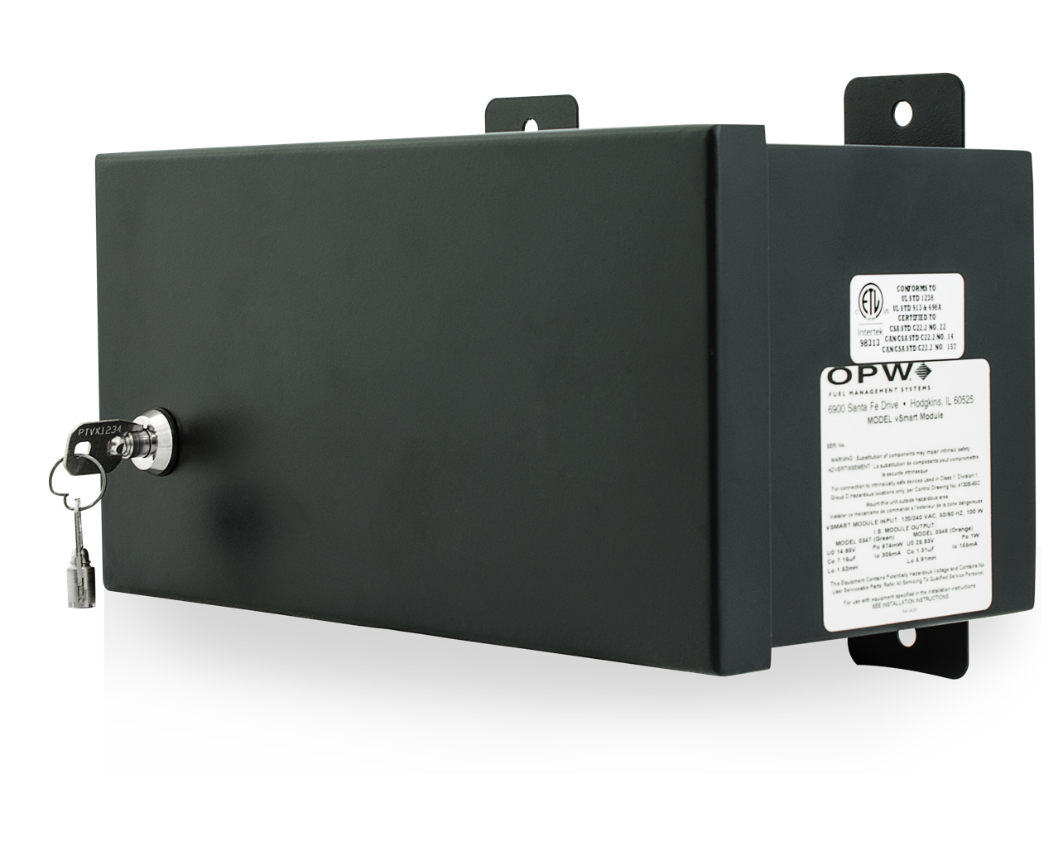
Key Benefits
The SiteSentinel® Integra™ 100 and 500 tank gauges are
Upgradeable and Expandable
Integra software can be
field-upgraded
The Integra 100 can be upgraded
to the Integra 500 via a simple
software upgrade
The Integra 500 can be expanded
to monitor up to 32 probes
via VSmart compatibility

Slide 6
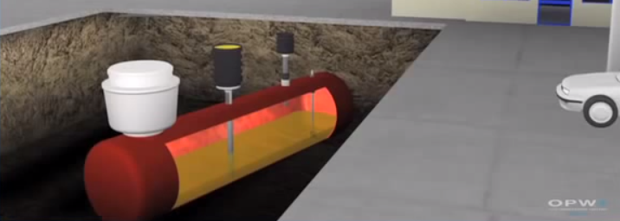
Features and Specifications
Precision Inventory Management
Provides gross and net-corrected tank volume, product level,
water level and temperature for individual tanks
Statistical Leak Detection provides continuous leak detection
Program Automatic Leak Detection to perform daily, weekly,
monthly and annual static leak tests
Volumetric Line Leak Detection is available

Slide 7
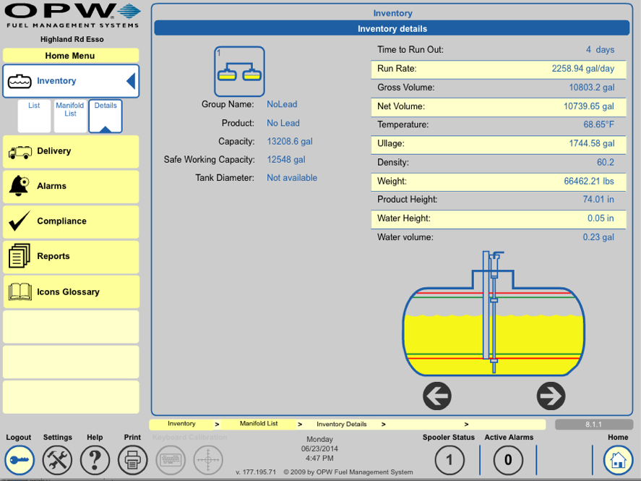
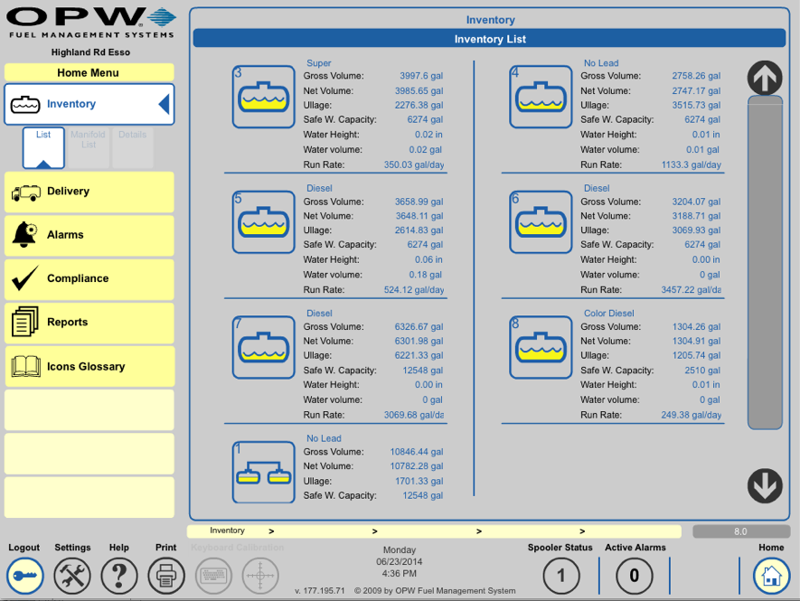
Features and Specifications
Software Functionality
Touchscreen delivers real-time inventory data, delivery status, alarm conditions and
leak-detection information
Communicates with industry-standard, third-party POS protocol and displays format commands
Includes address book of contacts to whom the gauge can send text messages, fax and/or emails on any alarms and events

Slide 8
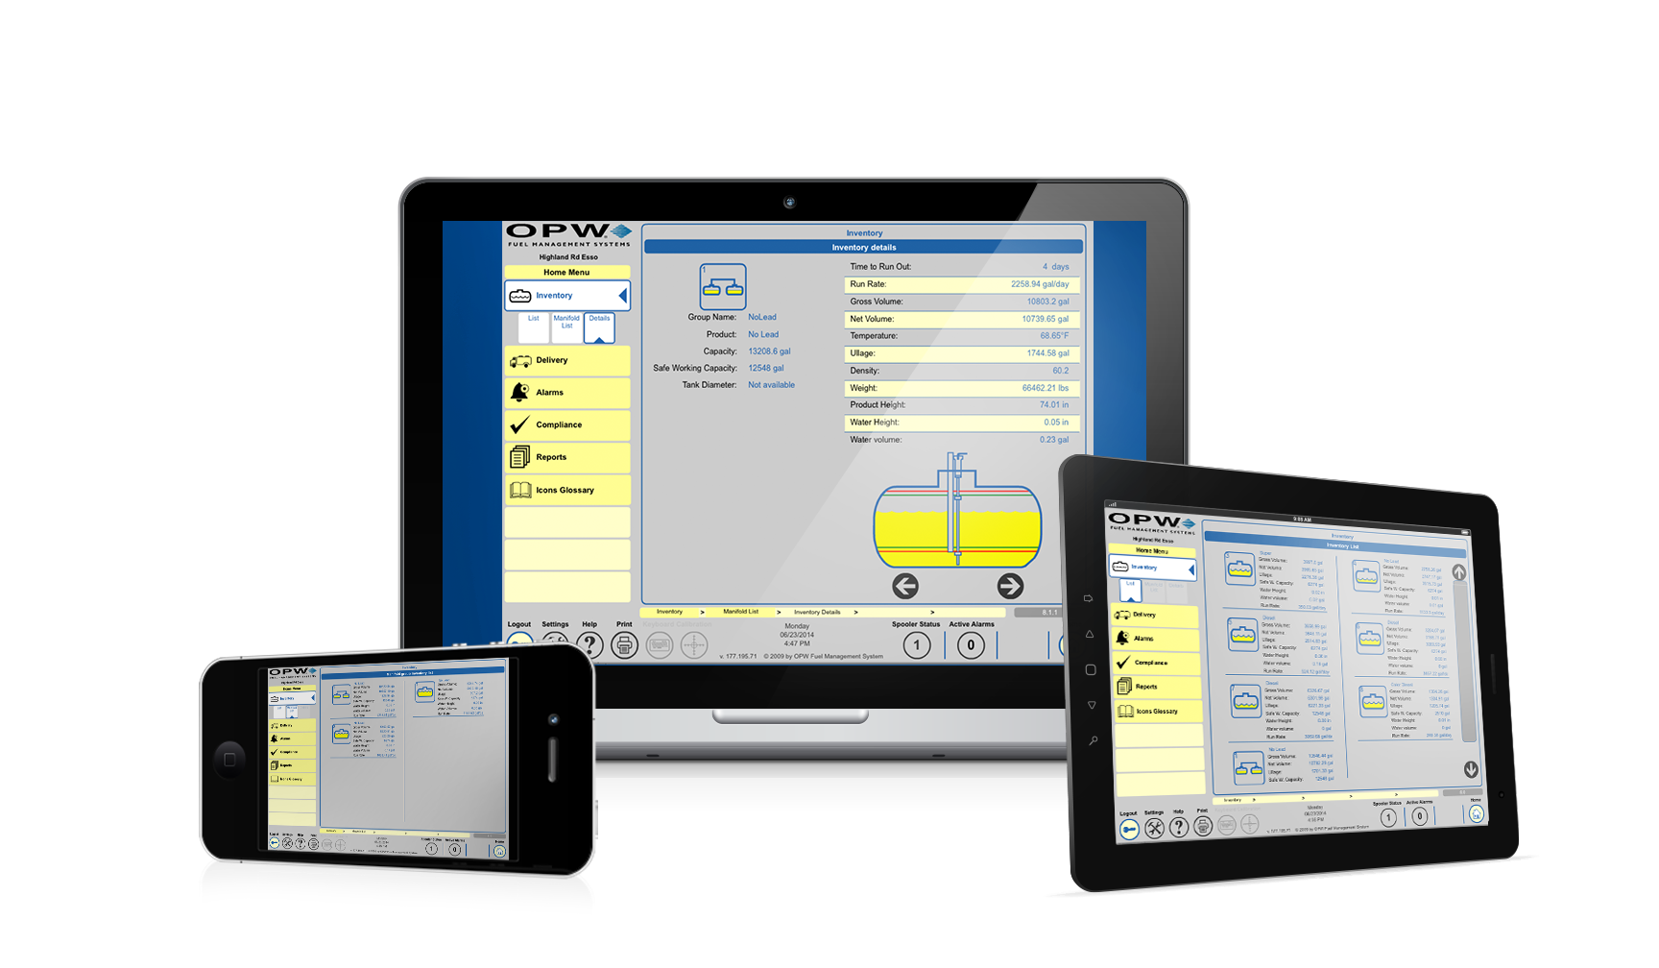
Features and Specifications
Remote Accessibility
Access data and interact with the gauge, from anywhere, on most devices
Train employees on gauge-related processes from one central location
Implement software updates and upgrades remotely
Support professionals can see what is happening with the gauge in real time for streamlines troubleshooting.

Slide 9


Features and Specifications
PRODUCT FEATURES …..........................
The industry’s largest color touchscreen displays real-time inventory data ^{from a single cock-pit view.}
Multi-drop technology substantially reduces needed in-installation wiring and installation labor.
^{Performs} Statistical Leak Detection (SLD) and programmable Automatic Leak Detection (ALD).
Automatic Calibration and Reconciliation (ACR) reconciles daily product sales and transaction data.
All digital devices – including probes, sensors and accessories – are automatically detected.
Built on a robust Microsoft® platform. Ethernet, RS-232 and USB are standard.
Browser interface enables remote configuration and remote access to real-time inventory data.
Receive instant alarm and alert notification through email, SMS (text message) and/or fax.
Can be upgraded to an Integra 500 via a software update at anytime while deployed in the field.
Can monitor up to 32 probes and 256 sensors and/or 16 Line Leak Detector Sensors.
SiteSentinel® VSmart compatibility gives the Integra 500 an extra potential barrier position.
Volumetric Line Leak Detection (VLLD) provides accurate and prompt ^{leak detection results.}

Slide 10
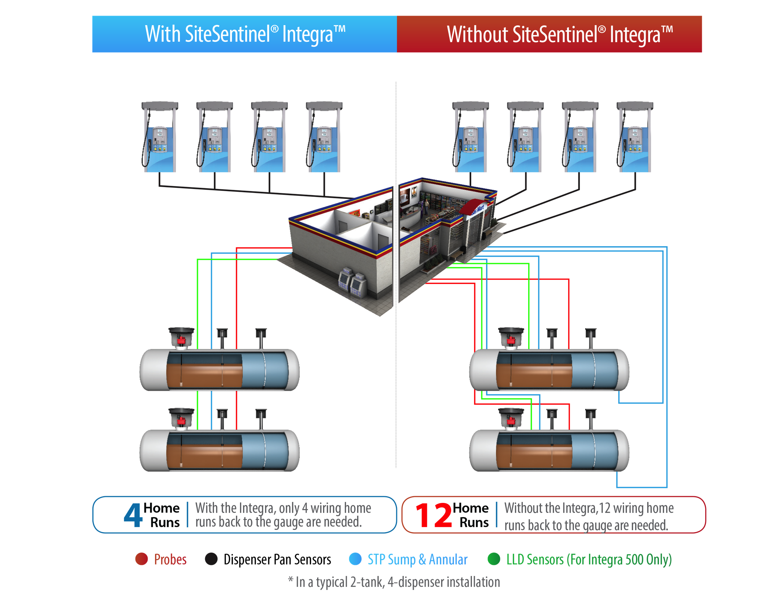
Features and Specifications
Multi-Drop Technology
Multiple probes and sensors can be run back to the gauge on wire
Reduces amount of wiring needed for a significant savings on wire expenses
Less wiring makes for a less labor intensive installation
Decreases site downtime needed for gauge installation or maintenance

Slide 11
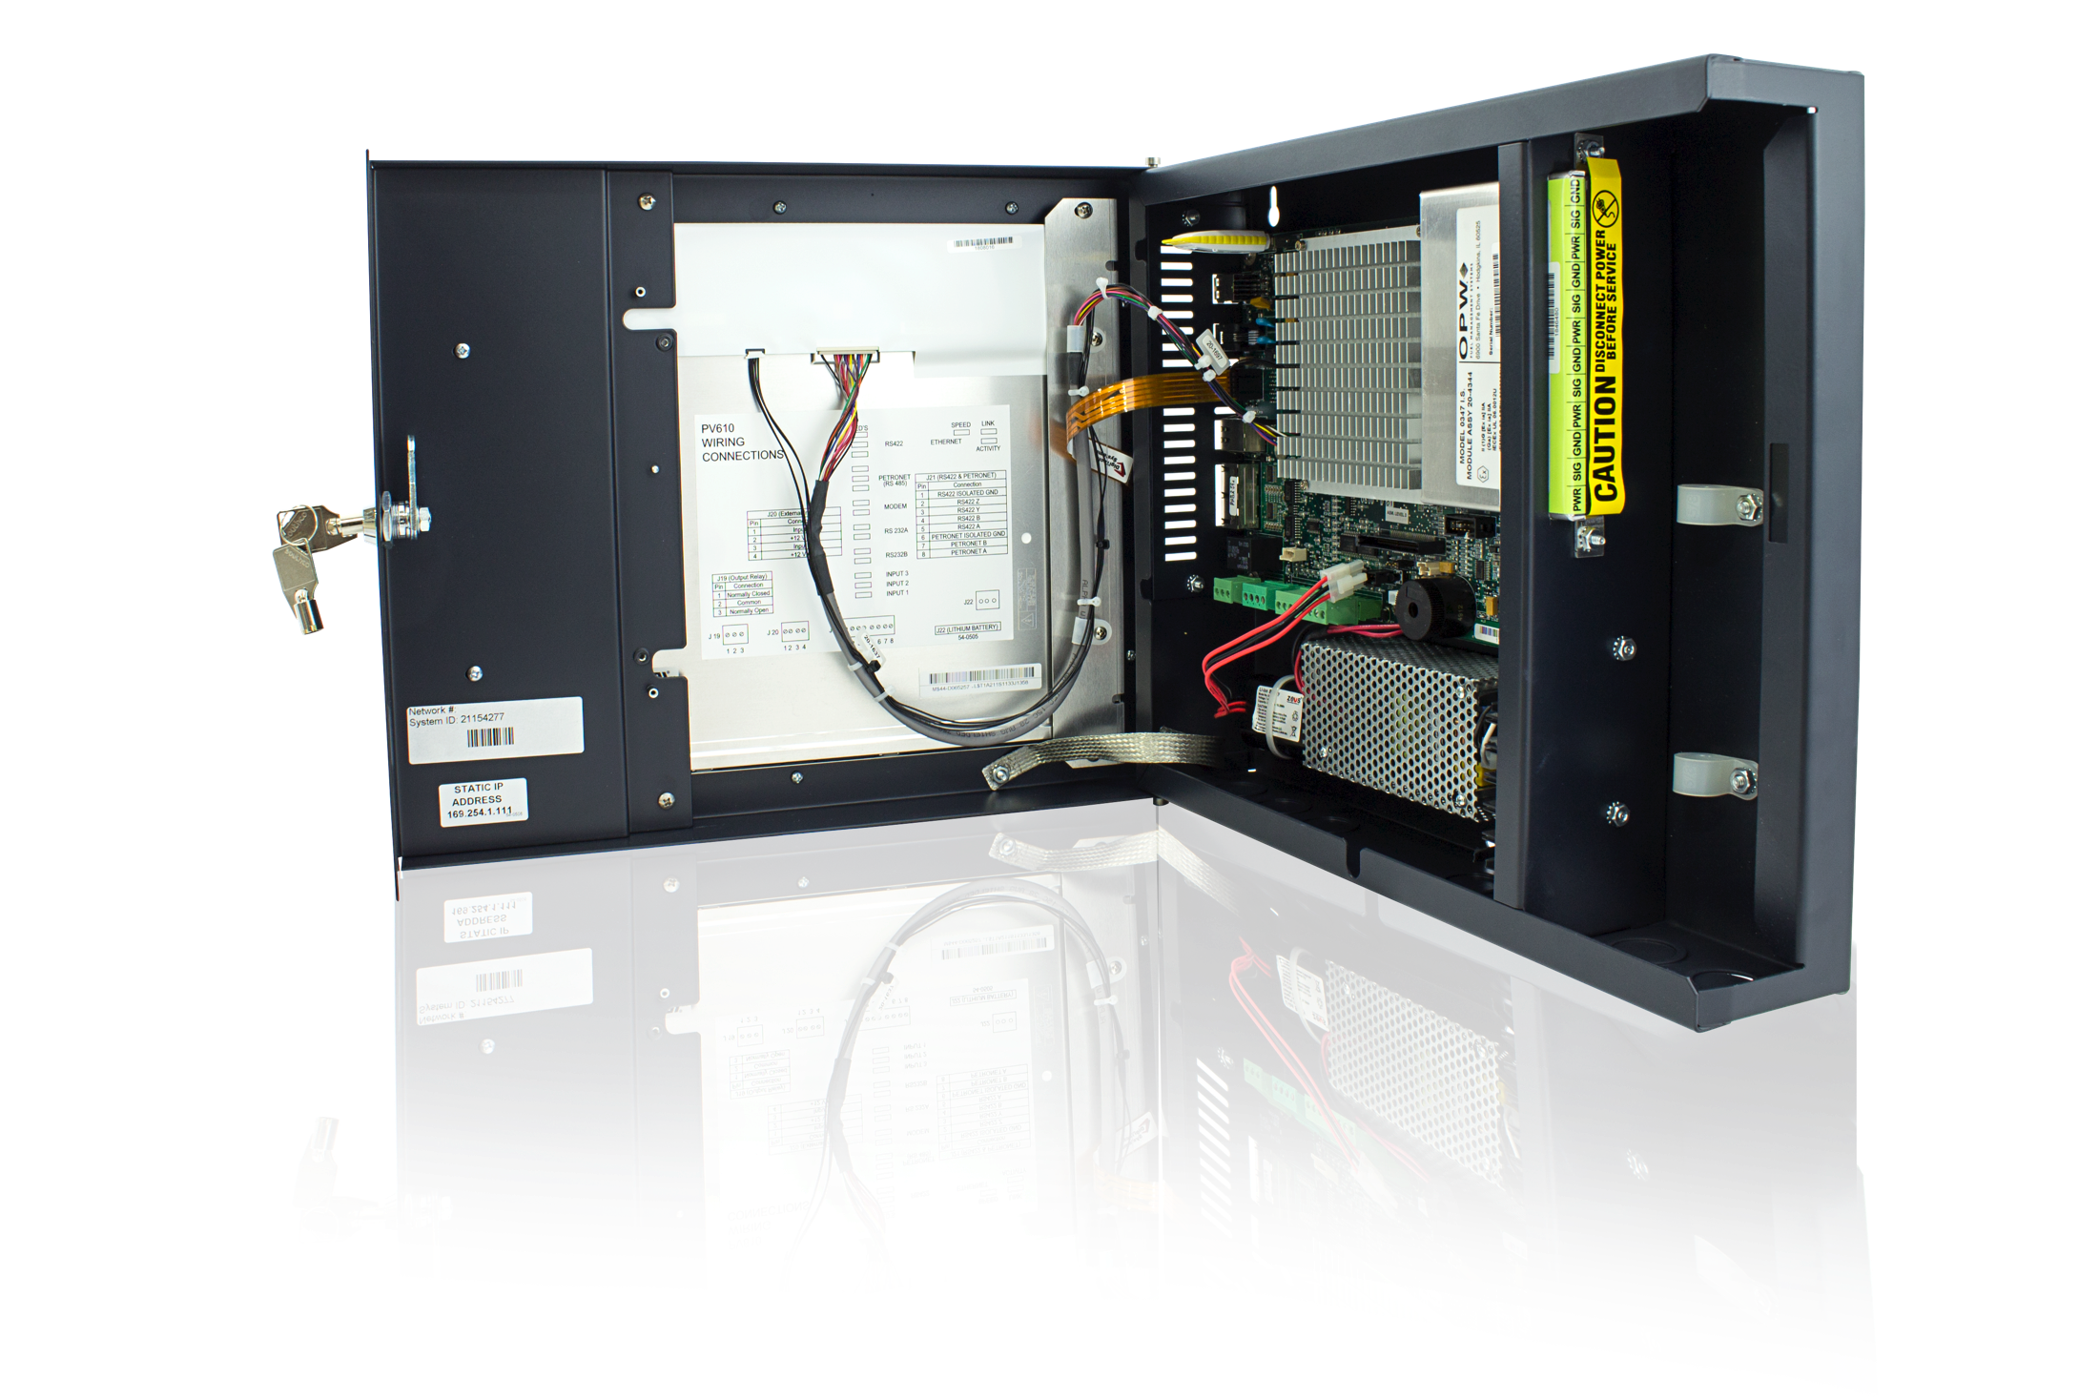
Features and Specifications
Dimensions and Display:
14.5 inch W x 12 inch H x 4 inch D (37 cm x 30 cm x 10 cm)
Operating Requirements:
32° F to 122° F (0° C to 50° C)
Typical Mounting Location:
Indoor, Non-Hazardous Area
Power Requirements:
96-264 VAC, 50/60 Hz
Humidity:
Non-Condensing (Max 95%)
Communication Ports:
  One (1) x Ethernet
  One (1) RS-485
  ( Integra 500 only)
  Two (2) x RS-232
  Two (2) x USB
  Two (2) Internal USB
  One (1) modem (optional)
Relays
Standard one (1) output and one (1) input internal relay connection
Up to 16 relays maximum, four (4) output relays per module using optional OM4 (Integra 500 only)

Slide 12
Q & A
Q
What kind of warranty coverage does the SiteSentinel® Integra™ offer?
12 months from date of installation or 18 months from manufacturer’s shipment date. Upgrades and replacement parts are covered for 90 days from the date of installation or for the remainder of the system’s original warranty, whichever is greater.
How difficult is it to configure the SiteSentinel® Integra™?
All digital devices are automatically detected and configured, making it one of the most user-friendly tank gauges in the industry.
A
Q
A

Slide 13

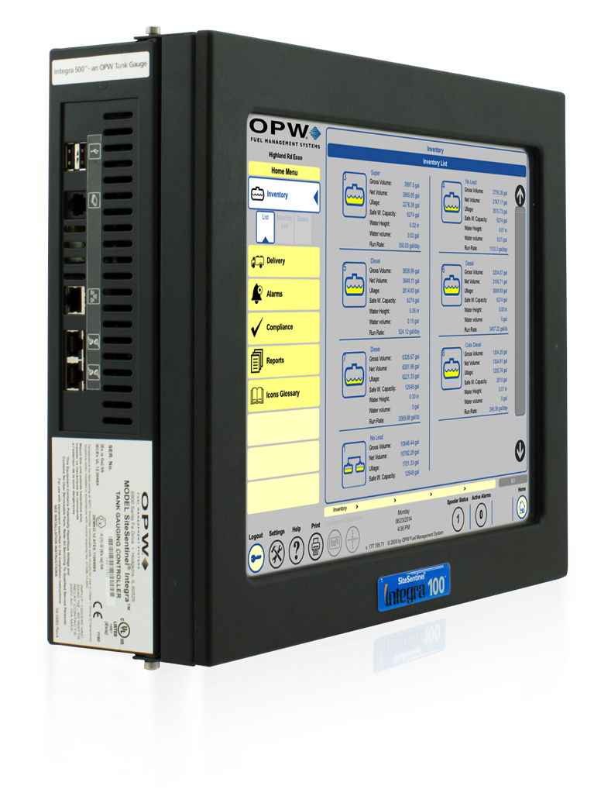
CONCLUSION
The SiteSentinel® Integra™ 100 and 500 tank gauges deliver
comprehensive monitoring capabilities for superior inventory management.
Easy to Use:
Economical:
A graphic touchscreen and remote access software provides a user-friendly experience.
The Integra significantly
reduces installation costs through multi-drop technology.
Upgradeable:
Versatile:
The Integra 100 can be upgraded to the Integra 500 via a software update; the Integra 500 can be expanded through VSmart capability.
Capable of monitoring 32 probes, the Integra is the ideal inventory management solution for even the largest fuel sites.

