Slide 1
OPW’s FSC3000™
Fuel Site Controller
Overview, Features and Benefits

Slide 2
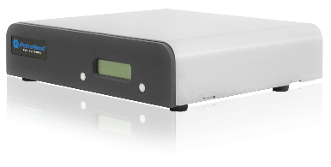
Product Introduction
The FSC3000™ Fuel Site Controller provides
comprehensive fuel management for fleet-fueling
or petroleum-marketing applications.
Secure: User-selected fueling
restrictions facilitate a tailored,
secure fueling system.
Integrated: The Fuel Site Controller interfaces with numerous proprietary and network cards as well as OPW Fuel Island Terminals and tank gauges.
Compatible: The FSC3000™ can control both mechanical and electronic pumps as well as Gilbarco CRIND and Wayne CAT in-dispenser card readers.
Robust Feature Set: A wide variety of feature options enable the FSC3000 to adapt to a range of fuel control needs.

Slide 3
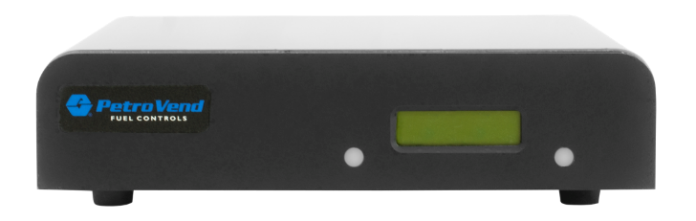
Key Benefits
The FSC3000™ Fuel Site Controller is
Reliable and Powerful
PCI compliance ensures cardholder data security
Each FSC3000 can control up to 12 FITs or Dispenser Terminal Controls with a maximum of 32 hoses per site
Dual memory card capabilities enable storage of up to 150,000 cards
Embedded hardware platform
provides 24-7 reliability

Slide 4
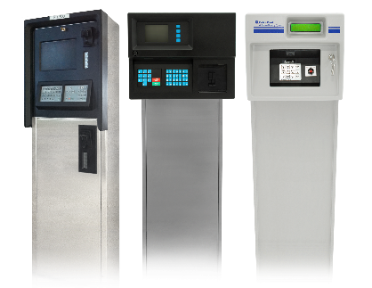
Key Benefits
The FSC3000™ Fuel Site Controller is
Versatile
Compatible with mechanical and electronic pumps and Gilbarco CRIND and Wayne CAT in-dispenser card readers
Integrated FSC3000™ can be installed
inside a Fuel Island Terminal for
installations where no building
is available
Interfaces with OPW tank gauges
for polling inventory and delivery data
Compatible with OPW Fuel Island
Terminals (C/OPT™, K800™,
Hybrid and FIT500™)
FIT 500™
C/OPT™
K800™

Slide 5
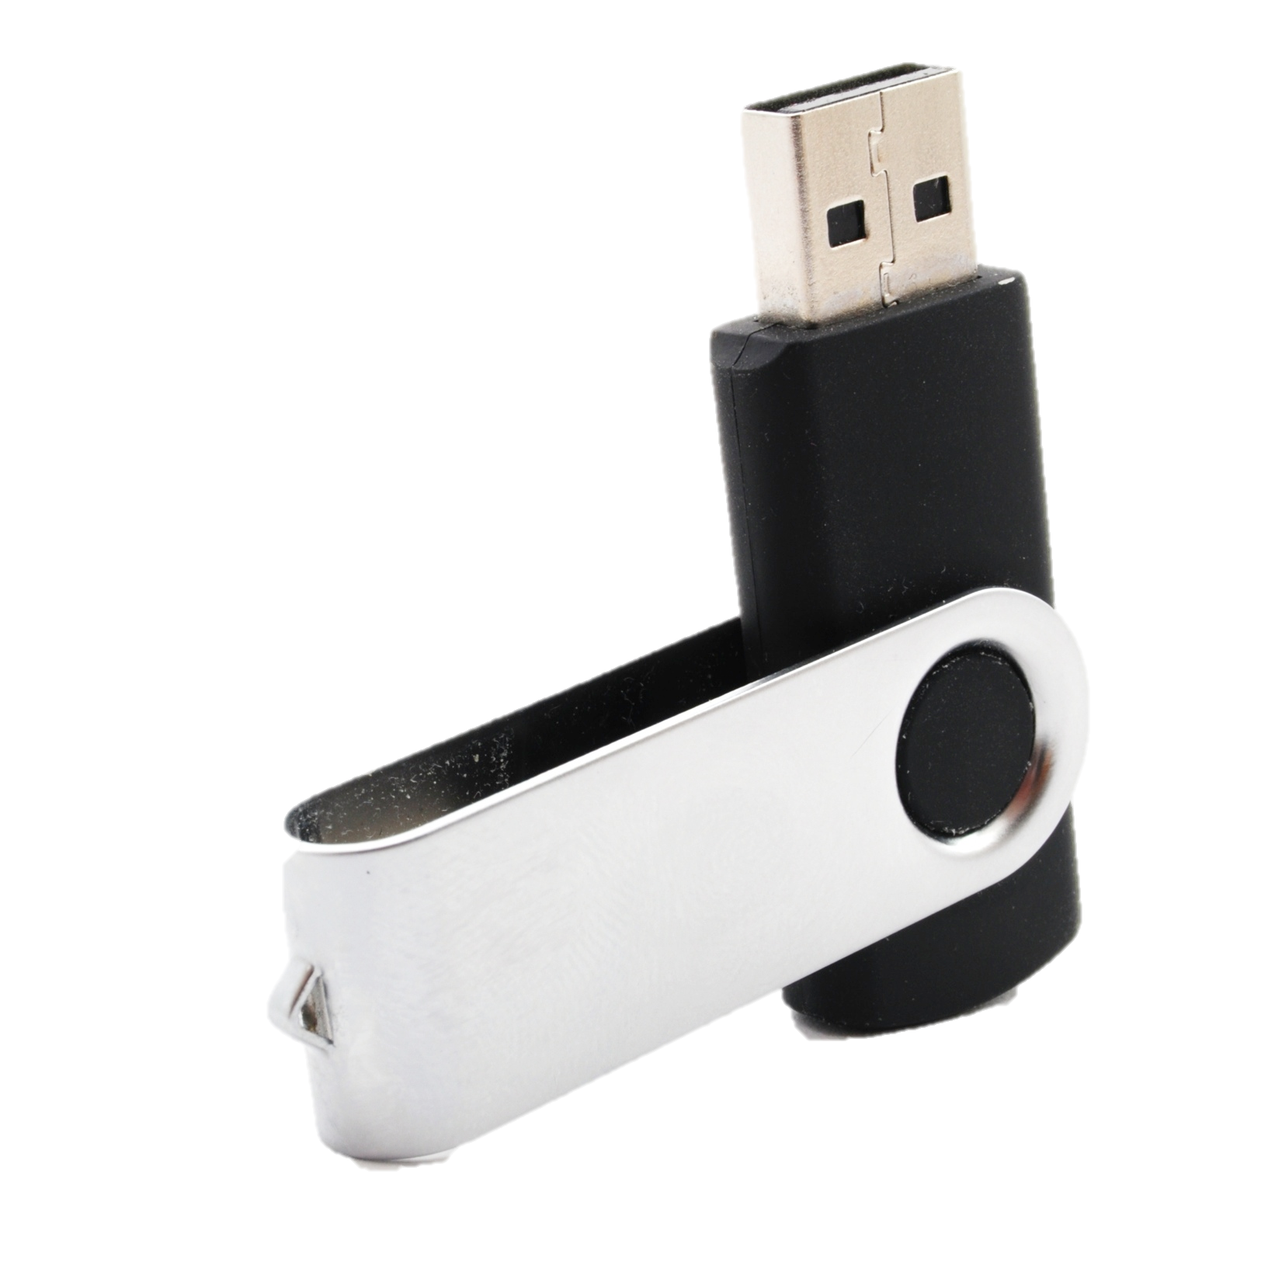
Key Benefits
The FSC3000™ Fuel Site Controller is
User-Friendly
Standard USB memory key for transaction backup/transfer, allowing for the option to update card files
Uses Flash technology to remotely
download software updates
Optional office journal printer
enables convenient transaction
logging and reporting

Slide 6
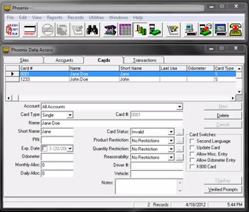
Features and Specifications
Interface Capabilities
Accepts the widest selection of fueling networks and major bank cards
Phoenix SQL®, Phoenix Premier™ and Phoenix Plus™ fuel management software packages are compatible with Windows®-based PCs
Provides ChipKey® Read/Write Mileage Reasonability
Offers PetroLink™ RFID access

Slide 7
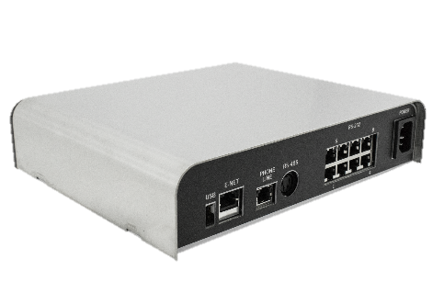
Features and Specifications
Robust Communication Connectivity
Built-in Ethernet port enables network connectivity
Optional IP Authorization Gateway provides a high-speed
Internet connection (with dial-up backup) to authorize transactions
Optional Wireless 3G modem, Bluetooth®, 802.11 Wi-Fi communication devices allow communication to remote locations

Slide 8



Features and Specifications
Strong Network Capabilities
The FSC3000 interfaces with many authorization and commercial fueling networks including: CFN, Bank Cards, TCH, Fuelman®/GASCARD, Comdata, Fleet One®, Wright Express®, T-Chek™, EFS, Pacific Pride and First Data’s Buypass
Dual Network option reduces wait times by accessing two networks simultaneously
Registered bankcard feature permits 24-hour fueling in areas where
unattended fueling is generally restricted

Slide 9
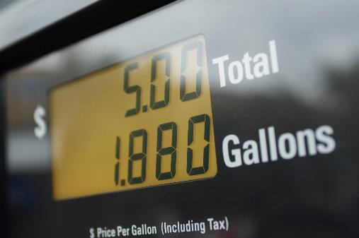
Features and Specifications
Numerous Options Available
Tiered pricing features allow users to set price discounts
Terminal Control enables communication to Gilbarco CRINDs and Wayne CAT
in-dispenser readers
Direct Pump Control facilitates
communication with Gilbarco,
Gasboy dispensers
900 MHz wireless communication
reduces cost of installing
Petro-Net™ twisted-pair wires
between the Fuel Island
Terminal and building
Future Media price-sign support

Slide 10
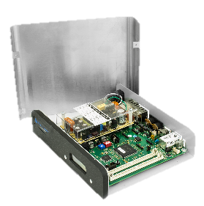
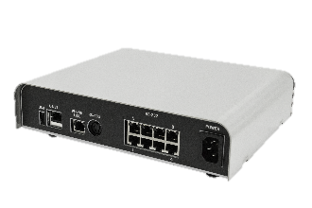
Features and Specifications
Dimensions:
2.25 inch H x 10.0 inch W x 8.25 inch D (5.7 cm x 25.4 cm x 21.0 cm)
Power Requirements:
85-240 VAC, 50/60 Hz; 25 watts maximum
Operating Temperature Range (indoors):
32°F to 122°F (0°C to 50°C)
Serial Communication Ports:
Petro-Net™ (RS-485)
Printer (RS-232)
Terminal (RS-232)
Modem (RS-232)
Pass-through (RS-232)
2 Auxiliary Ports (RS-232)
Ethernet
USB
Listings and Certifications:
Electronic Testing Labs
(ETL), per Underwriter Laboratories UL 1238
Electronic Testing Labs Canada (ETLC), per CSA C22.2 No. 22
National Weights and Measures Certification
Maximum Petro-Net™ Distance:
5,000 ft (1,524 m)
Phoenix® PC Requirements:
A Windows PC with 500 MHz or higher processor speed
128 MB RAM
Runs on a Windows® PC – compatible with Windows XP® or Windows Vista
CD-ROM drive
250 MB hard disk space
800 x 600 display
Available communications port

Slide 11
Q & A
Q
How does the FSC3000™ facilitate authorization of network bank cards?
When a network (Visa or MasterCard) bank card is swiped, the system will connect to the network and pre-authorize before the cardholder can fuel. Pre-authorizations occur since the final dollar amount of pay-at-the-pump transactions will not be known until the end of the transaction. In order to estimate the amount of a pay-at-the-pump transaction, Visa and MasterCard created $1 pre-authorizations.
Can the FSC3000 facilitate gift card authorizations?
Yes, for network-compatible gift cards the FSC3000 can
facilitate dollar amount authorizations.
A
Q
A

Slide 12
CONCLUSION
The FSC3000™ Fuel Site Controller provides
comprehensive fuel management for fleet-fueling
or petroleum-marketing applications.
Secure: User-selected fueling
restrictions facilitate a tailored,
secure fueling system.
Integrated: The Fuel Site Controller interfaces with numerous proprietary and network cards as well as OPW Fuel Island Terminals and tank gauges.
Compatible: The FSC3000™ can control both mechanical and electronic pumps as well as Gilbarco CRIND and Wayne CAT in-dispenser card readers.
Robust Feature Set: A wide variety of feature options enable the FSC3000 to adapt to a range of fuel control needs.

