Slide 1
OPW CleanEnergy Fueling Products
2013 Distributor Seminar

Slide 2
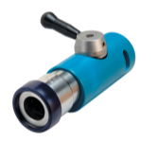
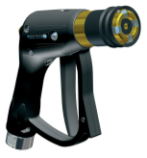
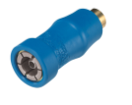
WHAT IS ?
Business Unit within OPW’s Above Ground Products Company since 1995
Serving the Alternative Fuels Market (CNG, LPG, Hydrogen)
Hanging Hardware (Fuel Dispensing)
Vehicle Fueling Receptacles
Manufacturing & Engineering Footprint: Cincinnati, Klasterec (CZ), Chennai, Mumbai

Slide 3
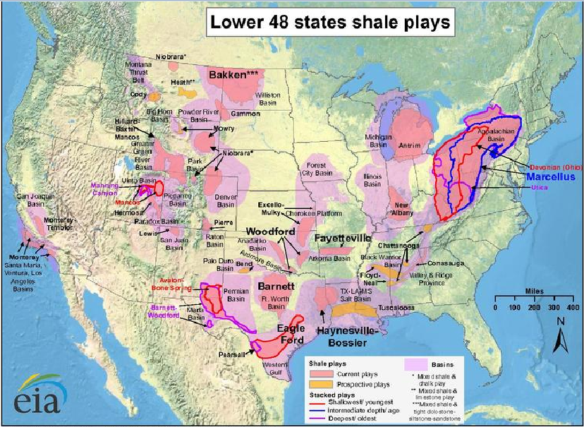
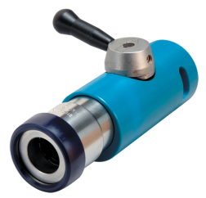
WHY ALL THE BUZZ ABOUT CNG & OTHER ALTERNATIVE FUELS?
Growth Drivers
Low-Cost NG – Shale Gas Plays (Reserves Projected at 150-200 years)

Slide 4
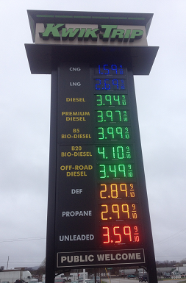
WHY ALL THE BUZZ ABOUT CNG & OTHER ALTERNATIVE FUELS?
Growth Drivers
Political
Made in the USA / Energy Independence
State & Federal Incentives
$.50/Gallon Tax Credit, 30% Infrastructure Tax Credit
The Chicken & the Egg – Infrastructure Build-Out
12 Liter Engine, Lower Conversion Costs, Retail Station Development, Auto OEM Developments
$1.59/GGE!!

Slide 5
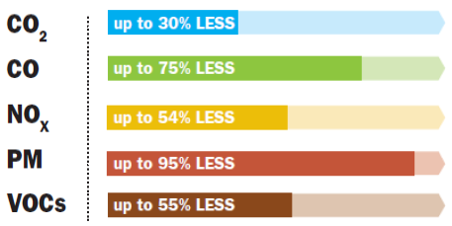
WHY ALL THE BUZZ ABOUT CNG & OTHER ALTERNATIVE FUELS?
Growth Drivers
Environmental
NGV’s reduces smog-forming & greenhouse gas emissions
NG is not toxic or corrosive & will not contaminate ground water

Slide 6
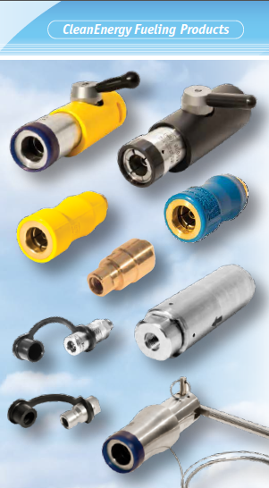
HOW DOES OPW GO TO MARKET IN THIS SPACE?
Emerging Market Challenges
OPW has not restricted its selling-channel strategy
Market Channels
Value-Added Resellers – Converters/Upfitters, Compressor Packagers
Integrators
OEM’s – Bus, Waste Hauling, Dispenser Manufacturers
End Users – Transit Authorities, Fleet Operators, Retail Fueling Stations
PEI Distribution

Slide 7
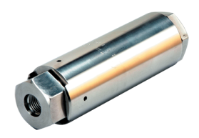
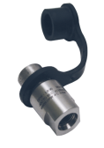
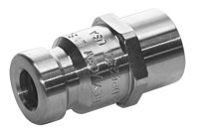
HOW CAN OPW HELP YOU WIN?
Quality
Continue delivering the highest quality product in the market
Service
Easy to do business with
Short lead-times
Technical resources
Education
Stay ahead of the fast-changing CNG standards
Communication regarding the compatibility of OPW’s products in the various CNG configurations

Slide 8
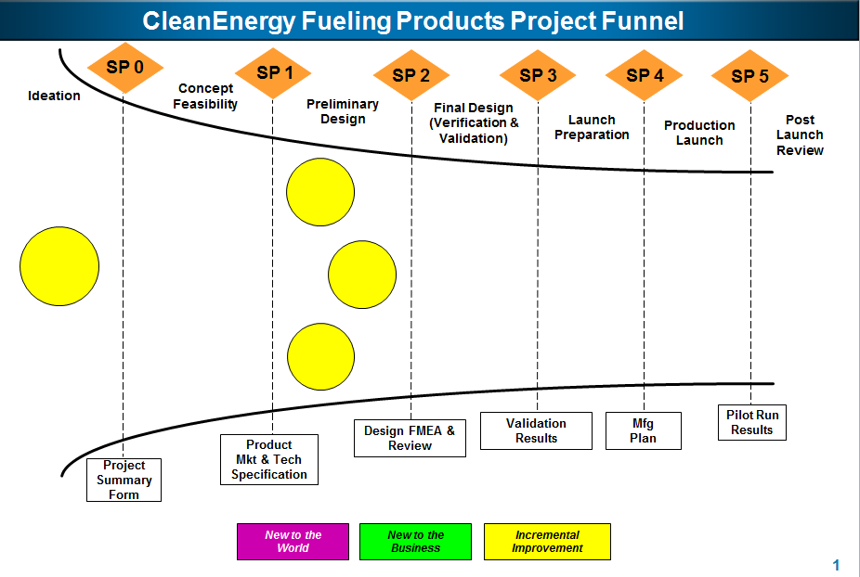
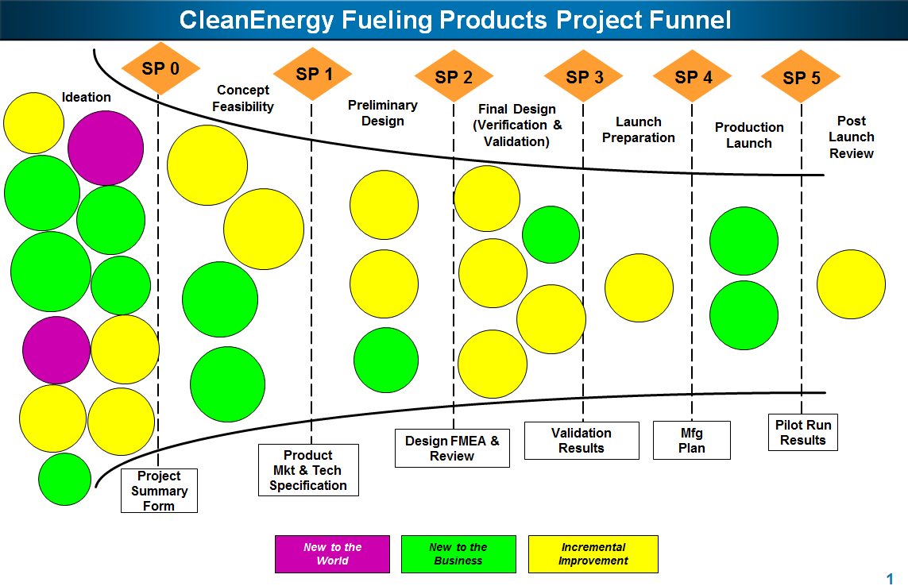
HOW CAN OPW HELP YOU WIN?
Product Innovation
Develop & commercialize new and innovative products to serve the alternative fueling industry
Aggressive application of resources to accelerate in this space, as evidenced by the project funnels below:
January 1, 2013 - - - - - - - - - - - - - - > July 1, 2013

Slide 9
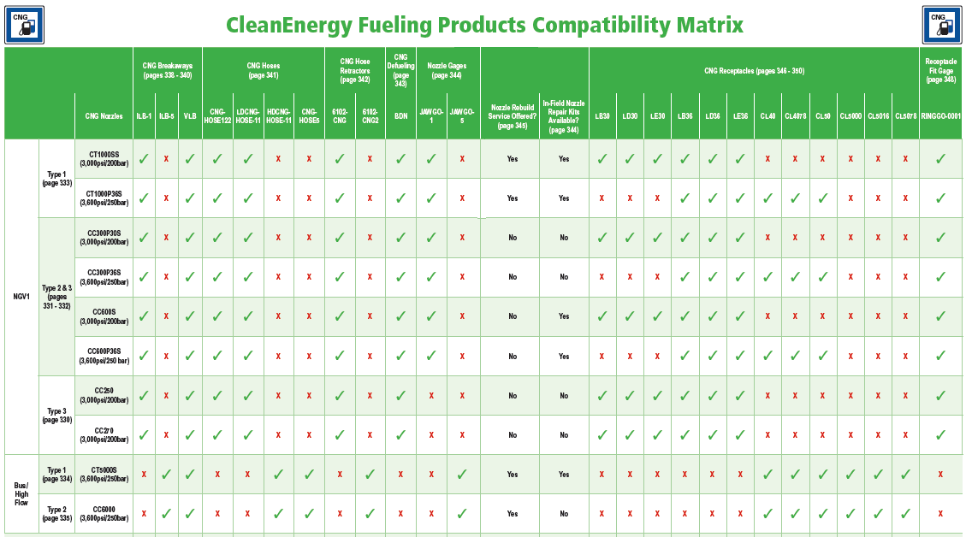
HOW CAN OPW HELP YOU WIN?
New CleanEnergy Fueling Products Catalog
Showcases OPW’s CleanEnergy Fueling Products offering
Compatibility Matrix – To assist you in determining the right solution for you and your customer
Glossary of Terms – Because a new language needs to be learned

Slide 10
HOW CAN OPW HELP YOU WIN?
Reach out to any of us as you begin your next alternative fueling project:
Inside Sales Rep/CSR
District Sales Manager
Erik Shelton
Director of Global Business Development,
CleanEnergy Fueling Products
eshelton@opw-fc.com
Cell 937-329-0032
QUESTIONS?

